Slide 1






Notes:
Who are FCL and USAble Life? We are an ancillary insurer provider wholly-owned by six Blue Cross Blue Shield Plans that sells through sixteen BCBS plans across the country.

Slide 2

Notes:
SLIDE GUIDE
BACKGROUND IMAGE: This imagery should be changed/replaced by the assigned Graphic Designer [via the Master Slide] and reflect the course content.

Slide 3

The #1 Dental Network in Florida
Our Copay and Choice PPO networks lead the industry as #1 and #2 in effective discounts in Florida¹, providing employers with the dental networks that are most successful at saving them money!
The most important measure of a network
Effective discounts reflect the savings when strong discounts are coupled with high in-network utilization
Power behind our results is a smarter network with the right number of the right dentists—at the right discounts
What are the results?
Lower premiums and out-of-pocket costs for employers and consumers
Minimizes future rate increases
¹ Ruark Consulting, “2016 PPO Network Study,” 2017. Other participants in the study include Delta, MetLife, Guardian, Aetna, Cigna, United Healthcare, and others

Slide 4
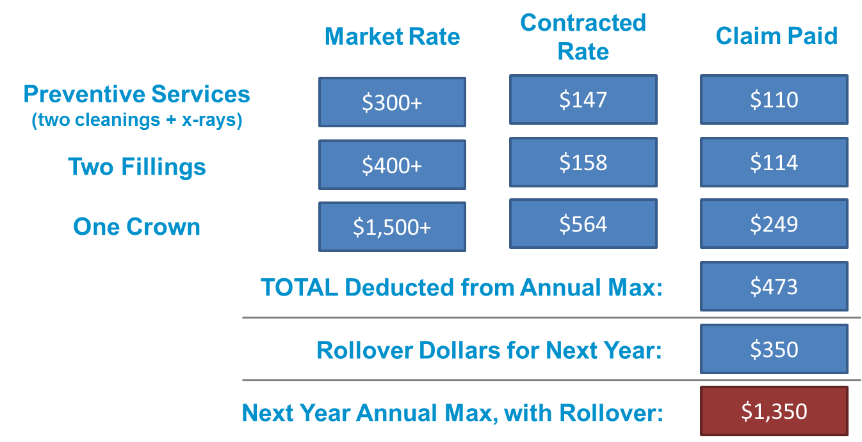
Dental Network and Rollover Benefits
The #1 Dental Network in Florida
Our Copay and Choice PPO networks lead the industry as #1 and #2 in effective discounts in Florida*, providing employers with the dental networks that are most successful at saving them money!
72,228 Unique Locations Nationwide
Our annual maximum goes much further than that of other carriers
The most important measure of a network
Effective discounts reflect the savings when strong discounts are coupled with high in-network utilization
Consumers have the ability to utilize the negotiated fee schedule for procedures during their 6 month waiting period.
Power behind our results is a smarter network with the
right number of the right dentists—at the right discounts
What are the results?
Lower premiums and out-of-pocket costs for employers and consumers
Minimizes future rate increases
$1,000 Annual Max Plan
*Ruark Consulting, “2016 PPO Network Study,” 2017. Other participants in the study include Delta, MetLife, Guardian, Aetna, Cigna, United Healthcare, and others
Notes:
TIPS
- THIS LAYOUT IS A BLANK CANVAS – BE CREATIVE or FILL WITH LENGTHY CONTENT
- Text Fields can be adjusted to fit your content.
IF YOUR ARE STUCK → Collaborate with your assigned Graphic Designer to fill the space ☺ they are there to help
Consider spacing of text to balance white space
Use for slides that require a lot of text

Slide 5
MAXIMUM ROLLOVER
With our plans, members’ unused benefit dollars from one year are “rolled over” to the next year
How does it work?
On average, members have major services every 3-5 years
Only a small percentage of members actually exceed the annual maximum
By Year 3, a qualifying member has the opportunity to double their annual maximum
Members can use the additional dollars to schedule higher out-of-pocket services in advance, providing added security for an unexpected issue
Rollover example: Based on an annual maximum benefit of $1,000
Maximum plan expenditure in a given plan year to qualify for the rollover benefit | $500
Amount that gets rolled over to the next plan year for those who qualify | $350
Year 2 annual maximum benefit ($1,000 + $350) for members qualifying for rollover in Year 1 | $1,350
Year 3 annual maximum benefit ($1,000 + $350 + $350) for members qualifying for rollover in Year 1 and 2 | $1,700
Total possible annual maximum benefit after 3 years (the amount a member can accumulate after 3 years of rollover is capped at $1,000) | $2,000

Slide 6
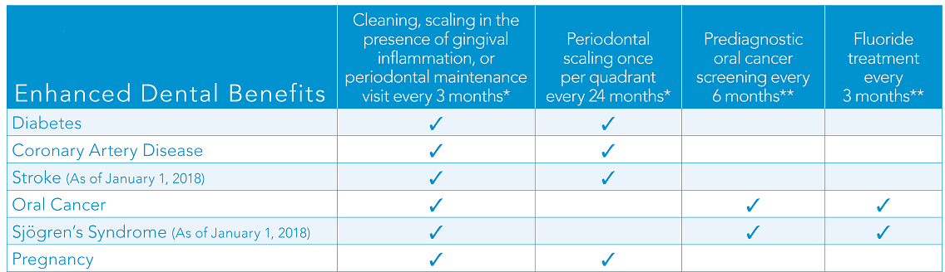
Oral Health for Overall Health
Medical Cost Savings Plus Enhanced Benefits
  Studies show significantly lower medical costs for members who use their preventive or periodontal dental services versus those who do not¹. This can lead to substantial savings for employers and members!
$889 extra benefits per year*
For average FL adult with Diabetes, CAD, or Pregnancy
$1,110 extra benefits per year*
For average FL adult with Oral Cancer
*Calculated using FairHealth dental claims data.
*Periodontal maintenance and scaling available with plans that offer periodontal benefits.
**This benefit is available for members previously diagnosed with oral cancer or for members diagnosed with Sjögren's syndrome.
¹Dental User Medical Cost Trend” conducted by Blue Cross Blue Shield plan (2016).
Notes:
SLIDE GUIDE
Place imagery by clicking the image icon, or drag/drop into the image field.
TIPS
To manually reposition or resize, select the crop tool after the image is placed.
+ Right click on the image and change the size via the dimension numbers displayed in the box that pops up.
+ If you want to delete portions of the picture, use the crop icon to the right of the dimension numbers in the pop up
Imagery Fields can be adjusted to properly display your screen shot

Slide 7
Oral Health for Overall Health: Medical Cost Savings Opportunity
  Studies show significantly lower medical costs for members who use their preventive or periodontal dental services versus those who do not*. This can lead to substantial savings for employers and members!
*”Dental User Medical Cost Trend” conducted by Blue Cross Blue Shield plan (2016).

Slide 9
Product Overview
HIGHLIGHTS
Coverage is available to the applicant and their dependents. Ages 19-64 on the effective date
Cash benefits are paid directly to the member to use as they choose
Policy is guaranteed renewable
Rates don’t increase due to age (locked into age at effective date)
Not coordinated with health plans
30-day free look period
Accident
Accident
Two plan choices that cover select accidents in addition to accidental death or dismemberment PLAN 2 has the most value
Critical Illness
$10K-$50K benefit options, upon first diagnosis of a covered illness (i.e. cancer, heart attack, stroke)
Hospital Confinement
Three plan choices that pay daily confinement amounts in addition to annual hospital admission and special ICU rates
Note: Agents must be appointed with USAble Life to sell these products. Start the process today by emailing Licensing@USAbleLife.com

Slide 10
Agent and Member Experience
Product | Competitive Minor changes to streamline portfolio
Sales Tool | SalesConnect Current health/dental sales tool
Underwriting | Automated
Binder Payment | Collected
Credit Card Payments | Accepted for binder payment USE CHECKING FOR RECURRENT BILLING
Billing Frequency | Monthly, Quarterly, Semi-Annual and Annual
Effective Dates | 1st and 15th of the month Based on business rules and submission date
Commissions | Paid monthly 30% of the 1st year premium More timely due to binder collection
Reporting | SalesConnect Sales Dashboard

Slide 11
Portfolio Changes
NEW PLANS
$18.04 Plan 2 Single person
ACCIDENT*
Lump sum payment for accidental death or dismemberment.
$30K (Basic) or $40K (Select) policy
Fixed schedule payment for treatment resulting from an accident
CRITICAL
ILLNESS**
$10K-$50K upon diagnosis of a covered illness (i.e., cancer, heart attack, stroke)
Carcinoma in situ: 10% only
Recurrent benefit included
 | Plan 1 | Plan 2 | Plan 3
Daily Confinement | $75 | $100 | $150
Hospital Admission | $800 | $1,000 | $1,500
Emergency Accident | not covered | not covered | not covered
 | $19.56 | $25.54 | $35.74
HOSPITAL
CONFINEMENT***
* Premium based off of single individual, Plan 1. | **Premium based on 40-year-old, non-smoking applicant with 30k of coverage, recurrent benefit, and 10% Carcinoma in Situ | ***Premium based on 49 year old individual applicant

Slide 12
Underwriting
Accident
Critical Illness
Hospital
Knock out questions determine eligibility (e.g. occupation & driver’s license)
Ineligible occupation list reduced from 24 to 14, no sub-industries
Application is either approved or denied
Medical underwriting questions sent via web service call
Results in <30 seconds
Applicants may be approved, denied, or approved for lower coverage
Medical underwriting questions sent via web service call
Results in <30 seconds
Application is either approved or denied

Slide 13
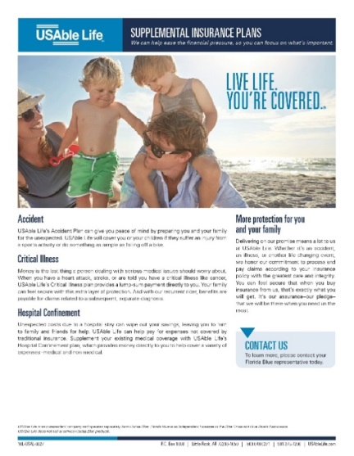
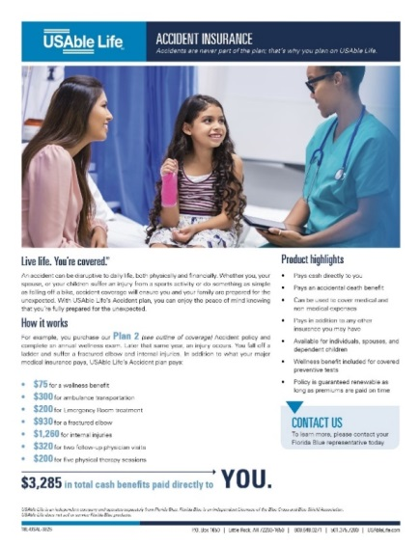
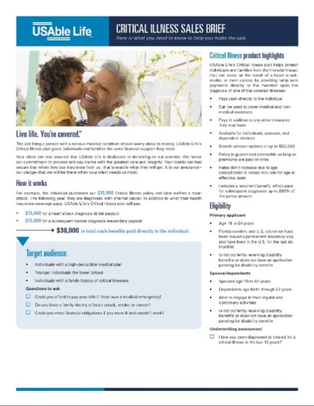
Newly Designed Collaterals
 | 1 Page Flyer | Outline of Coverage
Audience | Prospects | Consumers
Purpose | High level flyer that highlights the value of each product | Regulatory requirement to provide plan information during sales process

Slide 14
Agent Materials
 | Sales Briefs | Field Reference Manuals
Audience | Agents | Agents
Purpose | High level product and underwriting information, intended to assist agents in selling | Details to help agents with the sales and application process, as well as understand the details of the products

Slide 16


1. www.morganwhite.com
2. Portal Logins – Broker Portal
3. Individual Sales Platform(s) Customizations
4. Click on the eye logo
Vision benefits are offered through Morgan White Group.
Agent appointment necessary. (Contact Lauren)

Slide 17
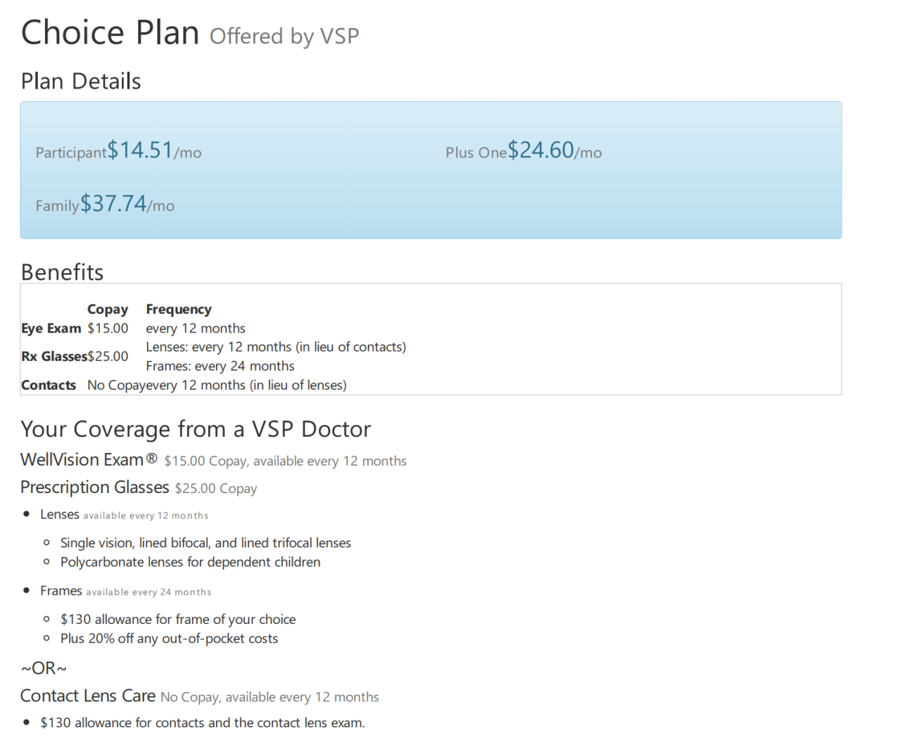
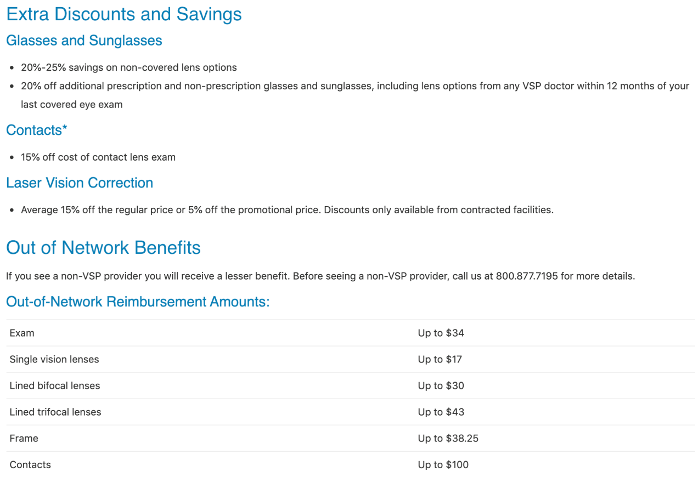
Summary of Benefit

Slide 19
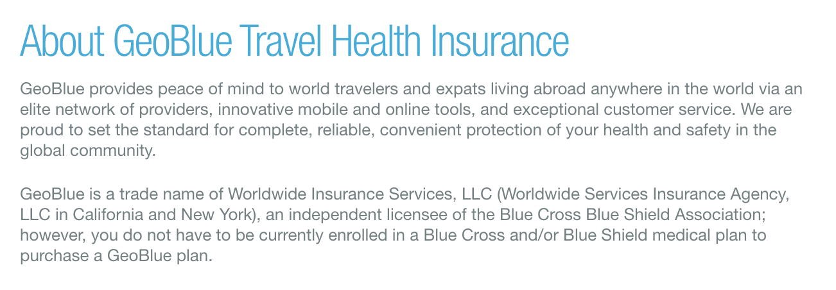




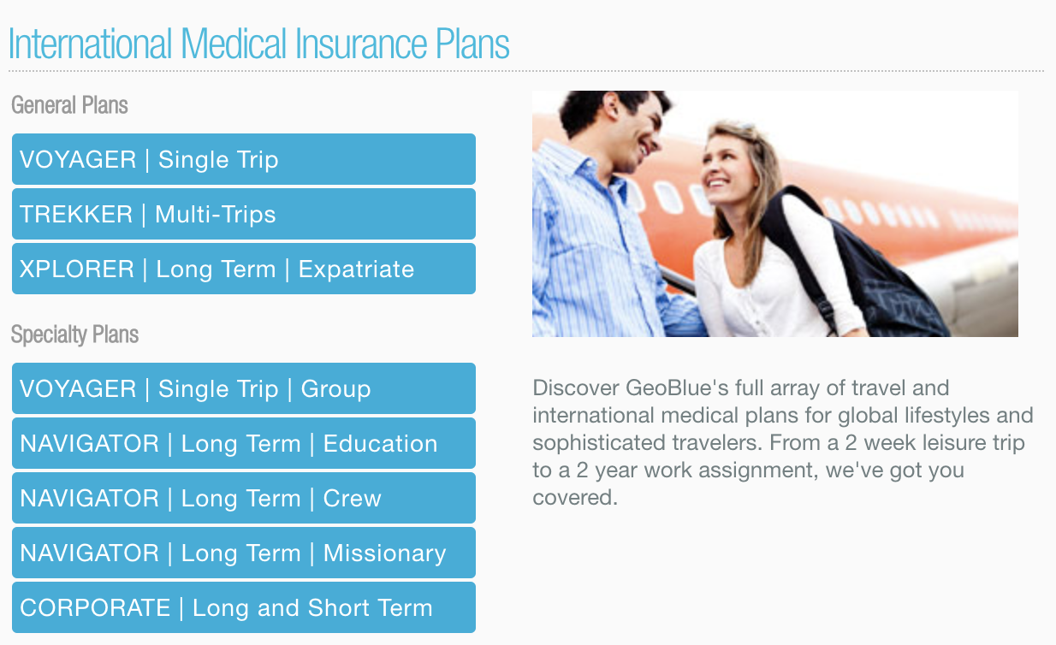
Agent appointment necessary. (Contact Lauren)
www.geobluetravelinsurance.com

Slide 20
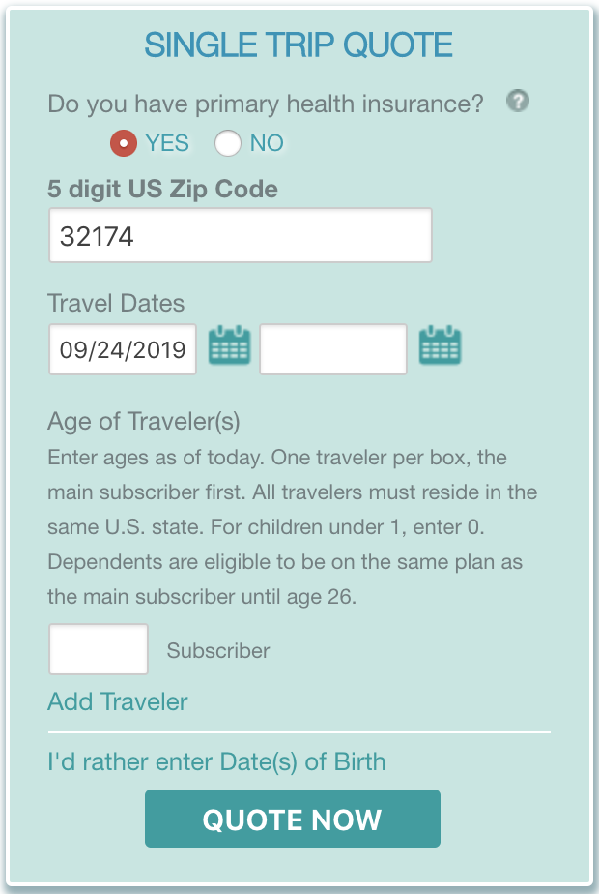

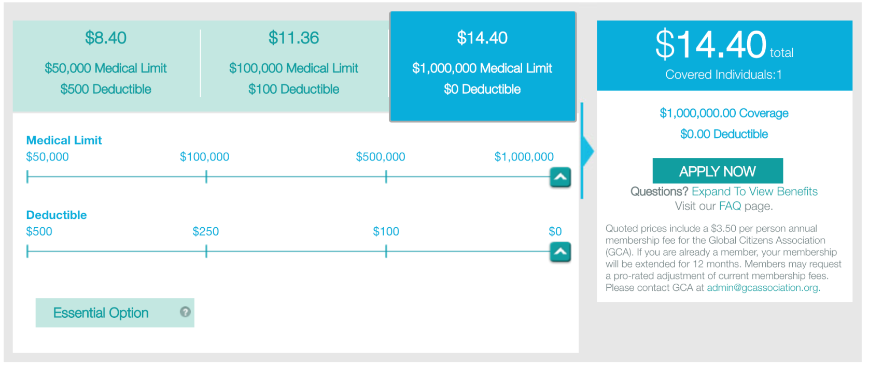
2
1
Once appointed with GeoBlue agents will have access to their own personal link.
Prospects must be a US Citizen.
3

Slide 21


Appropriate for Non US Citizens

Slide 22
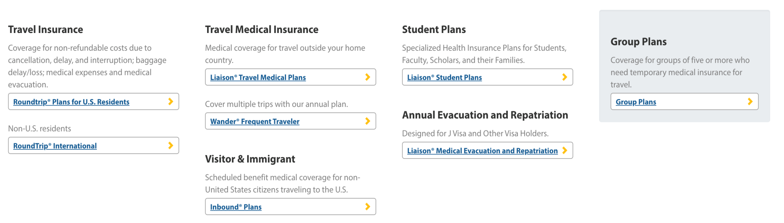
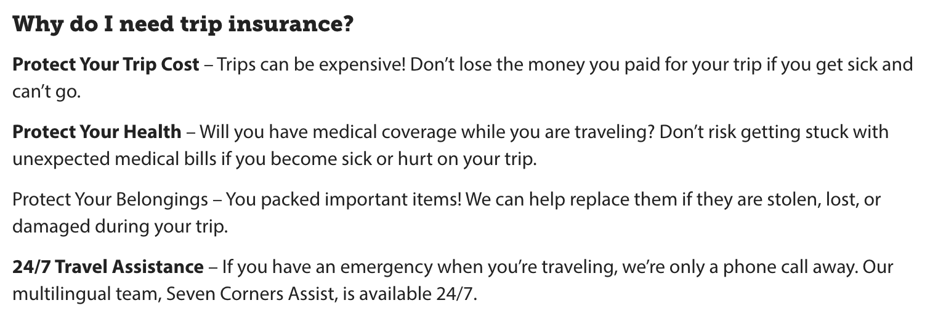
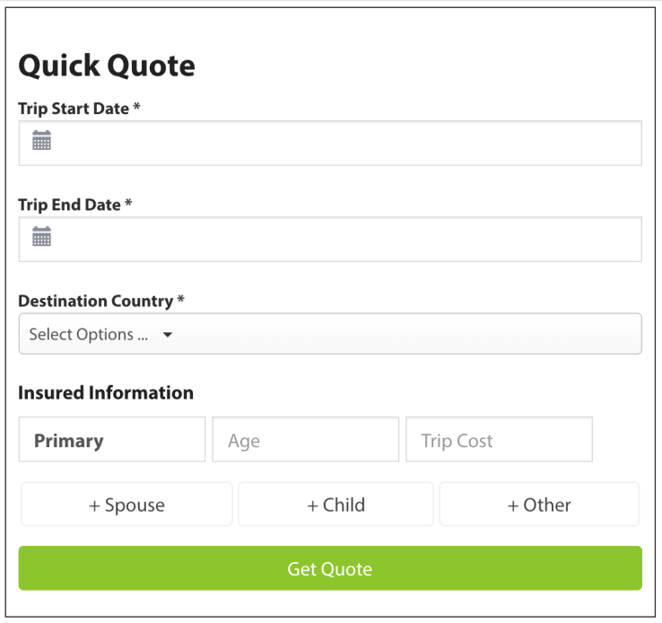
Agent appointment necessary. (Contact Lauren)
Travel insurance for immigrants visiting USA.
www.sevencorners.com

Slide 23

Small and Large Group Product

Slide 24
Nancy Kemper
nkemper@murrayins.net
(407) 332-0909
Group Insurance
Murray Insurance Agency offers a diversity options in group health coverage through our partners Rogers Benefit Group, Also as an Agency we count with the support of CoAdvantage as a PEO’s to help in covering all the needs of a business owners, such as:
Workers Comp
Admin Fees
Employee Onboarding
Compliance
Claims (Work Comp, Unemployment, Etc.)

Slide 25

To start the Quoting Process
Small Group Quote Request Form
AOR Letter Example – FB
For more information, please contact:
Nancy for group
Lauren for Appointments

Slide 26
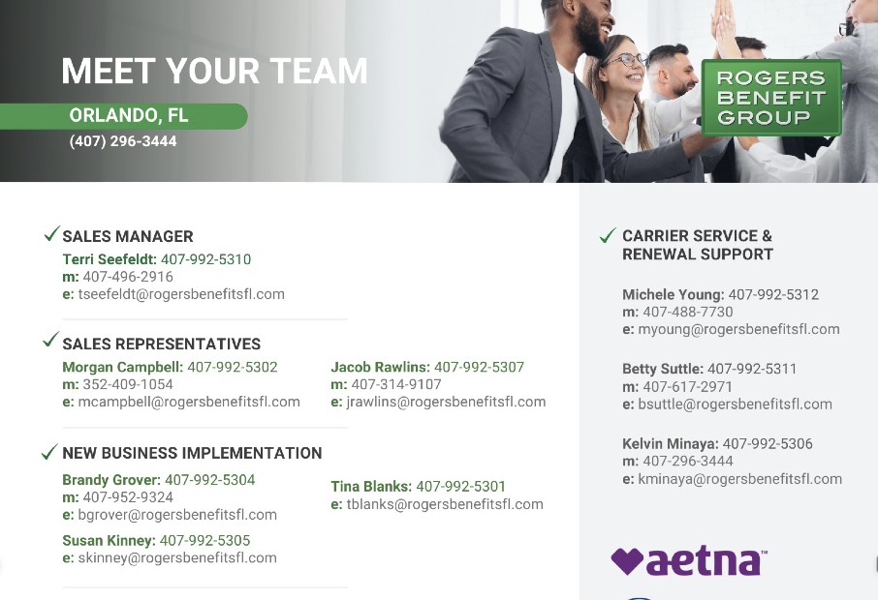

Slide 27
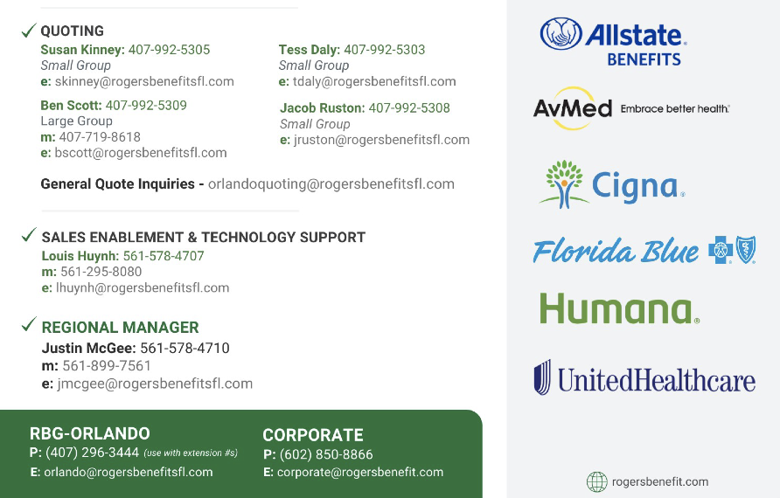

Slide 28


Final Expenses
Life
Disability
Annuities

Slide 29

Final Expenses | Life | Disability | Annuities
Murray Insurance Agency offers Final Expenses, Life, Disability and Annuities through our partner AMERILIFE
Our below partner will also assist you to sell:
Name: Devon Williams
Company: AMERILIFE/ GTL.
Phone: (800) 531-1411 X 72206
Fax: (727) 489-6900
E-mail: dwilliams@agentconnection.net
Agent Portal Life Proposal Video (Agent use only). This will guide you through the process.
https://drive.google.com/file/d/1mSj4lqCBiTrsHO3KI-yTUD4k6l_5P44g/view?usp=sharing
New agent appointments are only completed when submitting business.

Slide 30

S
M
A
R
T
YOUR SUPPORT TEAM
JUST A CALL/TEXT/EMAIL AWAY
STEPHANIE
Our Fearless Leader!
MELANIE
System and Reports
AgencyBloc Support
Operations
ADA
Onboarding Training
Product Support
She has the answer!
RENEE
All Marketing
Community Outreach
PCP Connection
TRISTA
In Field Agent Training
Organizer
Lauren: Carrier appointments, Customer Support/Service Blue & FHCP U65.
Nancy: Group Guru! HELPS MAKE YOU STEADY INCOME!
Michaelene: C.F.O. – Money, Money, Money!
Lourdes: Events and Seminars

Slide 31
CONTACT NUMBERS/ EMAIL
Murray Office Team: 407-332-0909 Main Number 8:30am – 5:00pm EST
Lauren Savickas
407-227-5667 cell
lsavickas@murrayins.net
Melanie Livingstone
407-970-5220 cell
mlivingstone@murrayins.net
Ada Jimenez
407-760-5585 cell
ajimenez@murrayins.net
Trista Anderson
386-566-9625 cell
tanderson@murrayins.net
Renee Cline
407-421-3295 cell
rcline@murrayins.net
Stephanie Aldridge
407-716-7312 cell
saldridge@murrayins.net
Nancy Kemper
407-489-2334 cell
nkemper@murrayins.net
Michaelene Criswell
mcriswell@murrayins.net
STILL DON’T KNOW WHO TO ASK? Call Melanie, she will direct you to the right person!

Slide 32
CARRIER AND PARTNER ASSISTANCE
Florida Blue/ FHCP
Florida Blue (All Members) / FHCP (Over65) AGENT Support
Carmen Mejia-Hill (Murray’s dedicated Support person)
1-800-267-3156
dedicationASC@floridablue.com
Refer MEMBERS to Florida Blue (Under65 Members) Customer Service
1-800-352-2583
Florida Blue (Over65 Members) Customer Service
1-800-926-6565
FHCP CASHIER
386-676-7100 ext. 7312
FHCP MEMBER SERVICES
1-386-615-4022
Group Insurance
Rogers Benefits Group
Quoting
Susan Kinney
orlandoquoting@rogersbenefitsfl.com
Sales
Jacob Rawlins
407-314-9107
jrawlins@rogersbenefitsfl.com
Service/Renewals
Michele Wawoe
407-488-7730
mwawoe@rogersbenefitsfl.com
Contact information

Slide 33
Notes:
FILE #: 103000918

