Slide 2
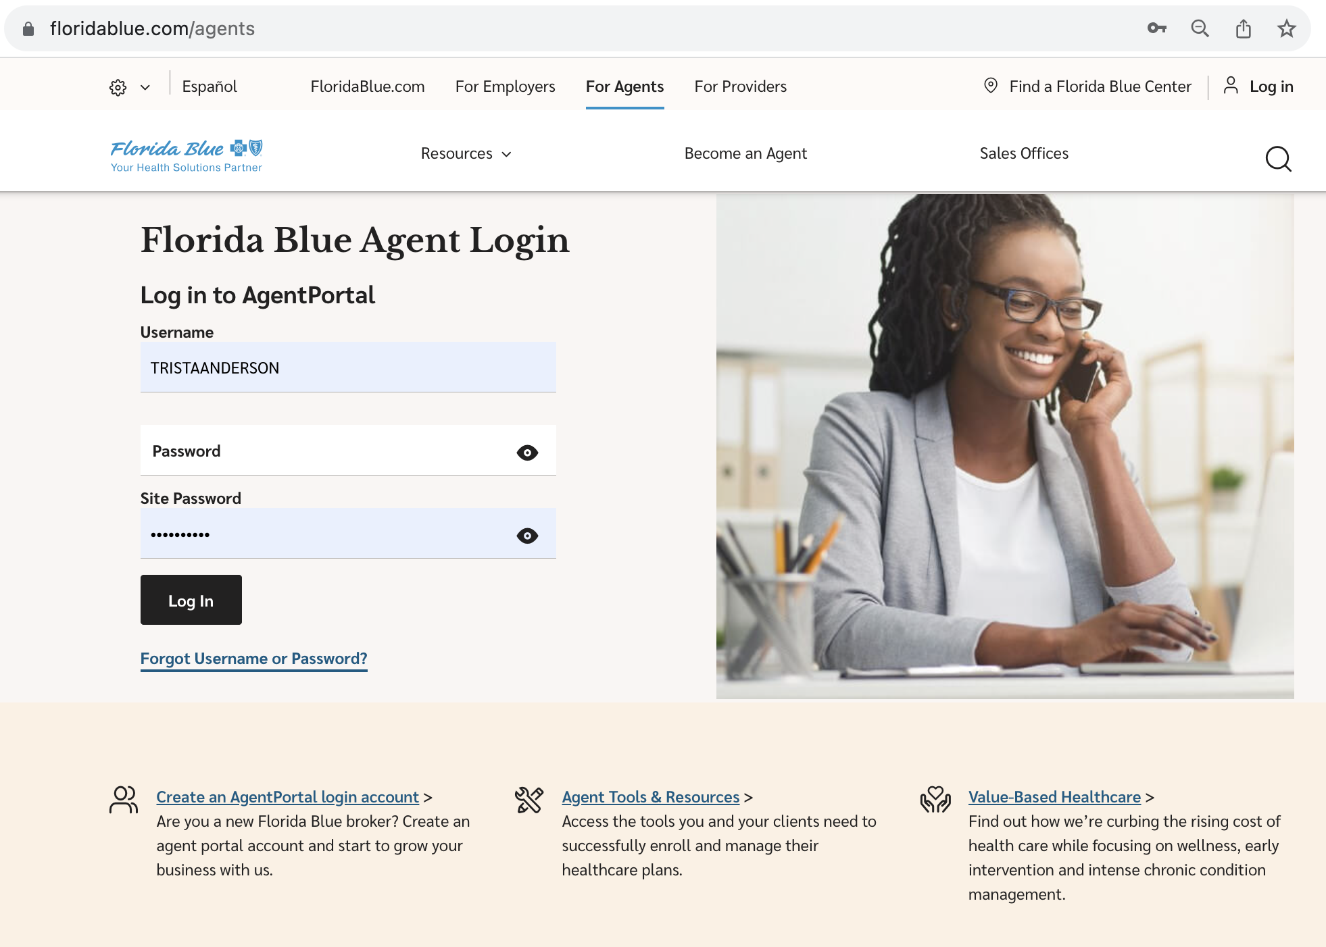
Once your paperwork have been processed you will received an email to register on the Florida Blue Website agent portal. https://www.floridablue.com/agents
Once registered you need to login by using your username, password and site password that you have created.
Step by step in how to process an ACA application.

Slide 3
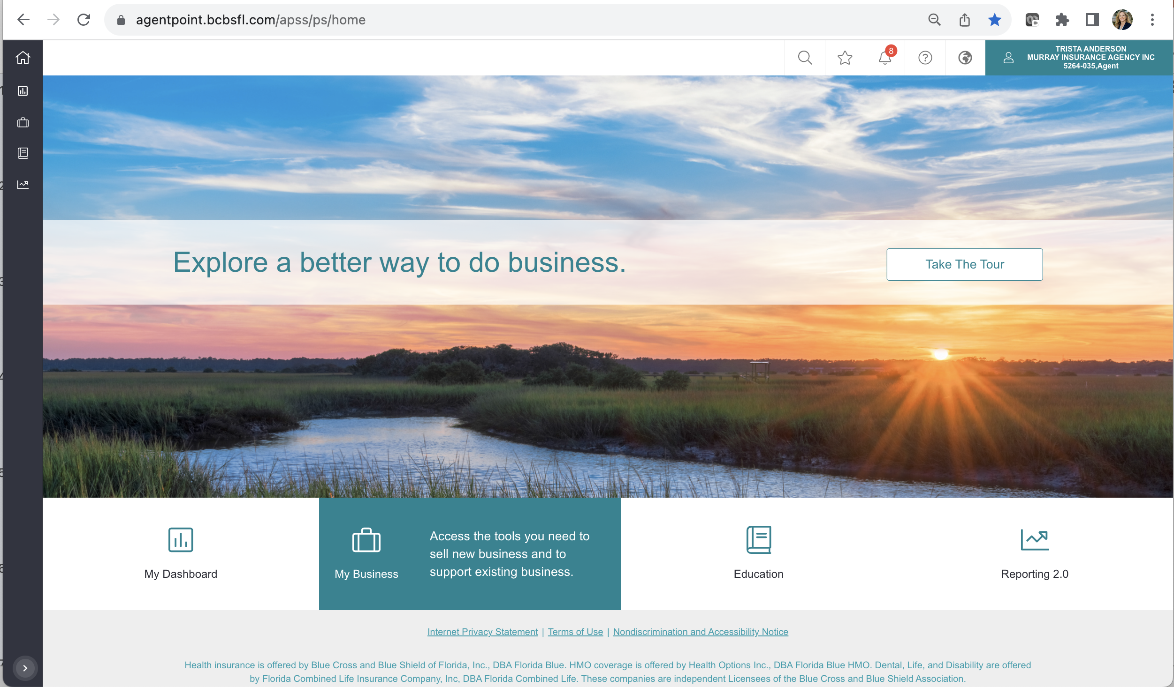
1. Click on Individual Sales – Process Applications. Here is where you going to click to process applications for: Individual & Family, Medicare Advantage, Medicare Supplement, Dental, USAble and Temporary Insurance.

Slide 4
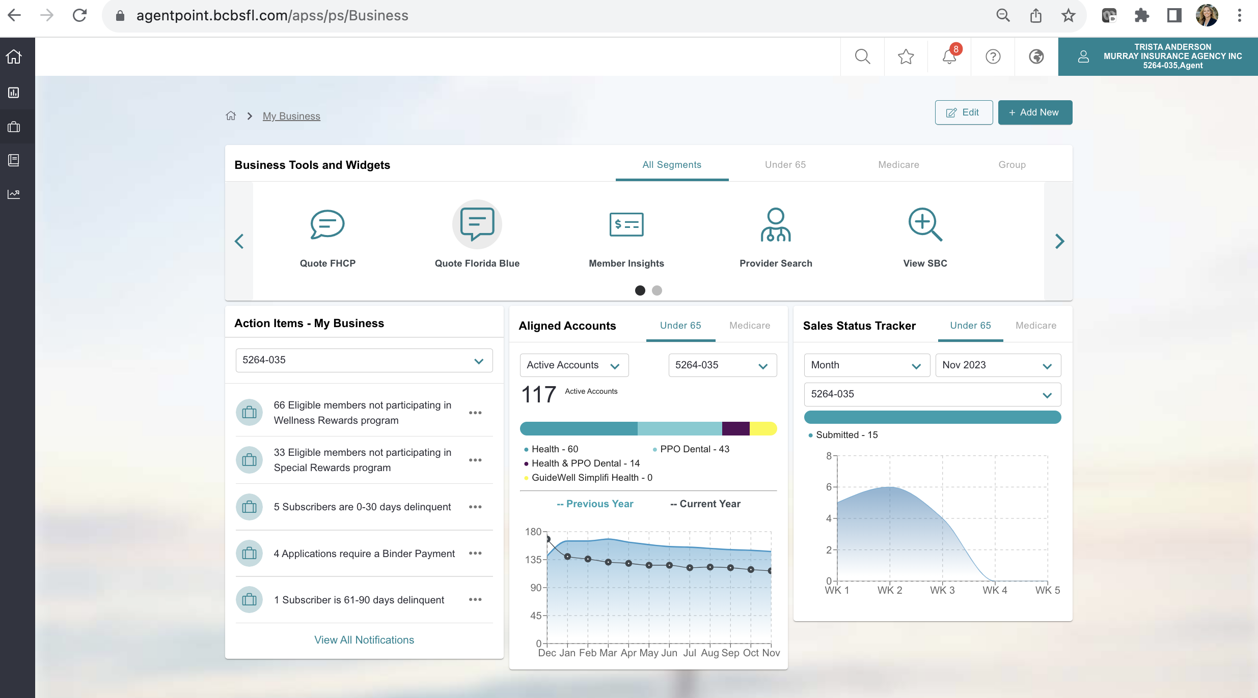
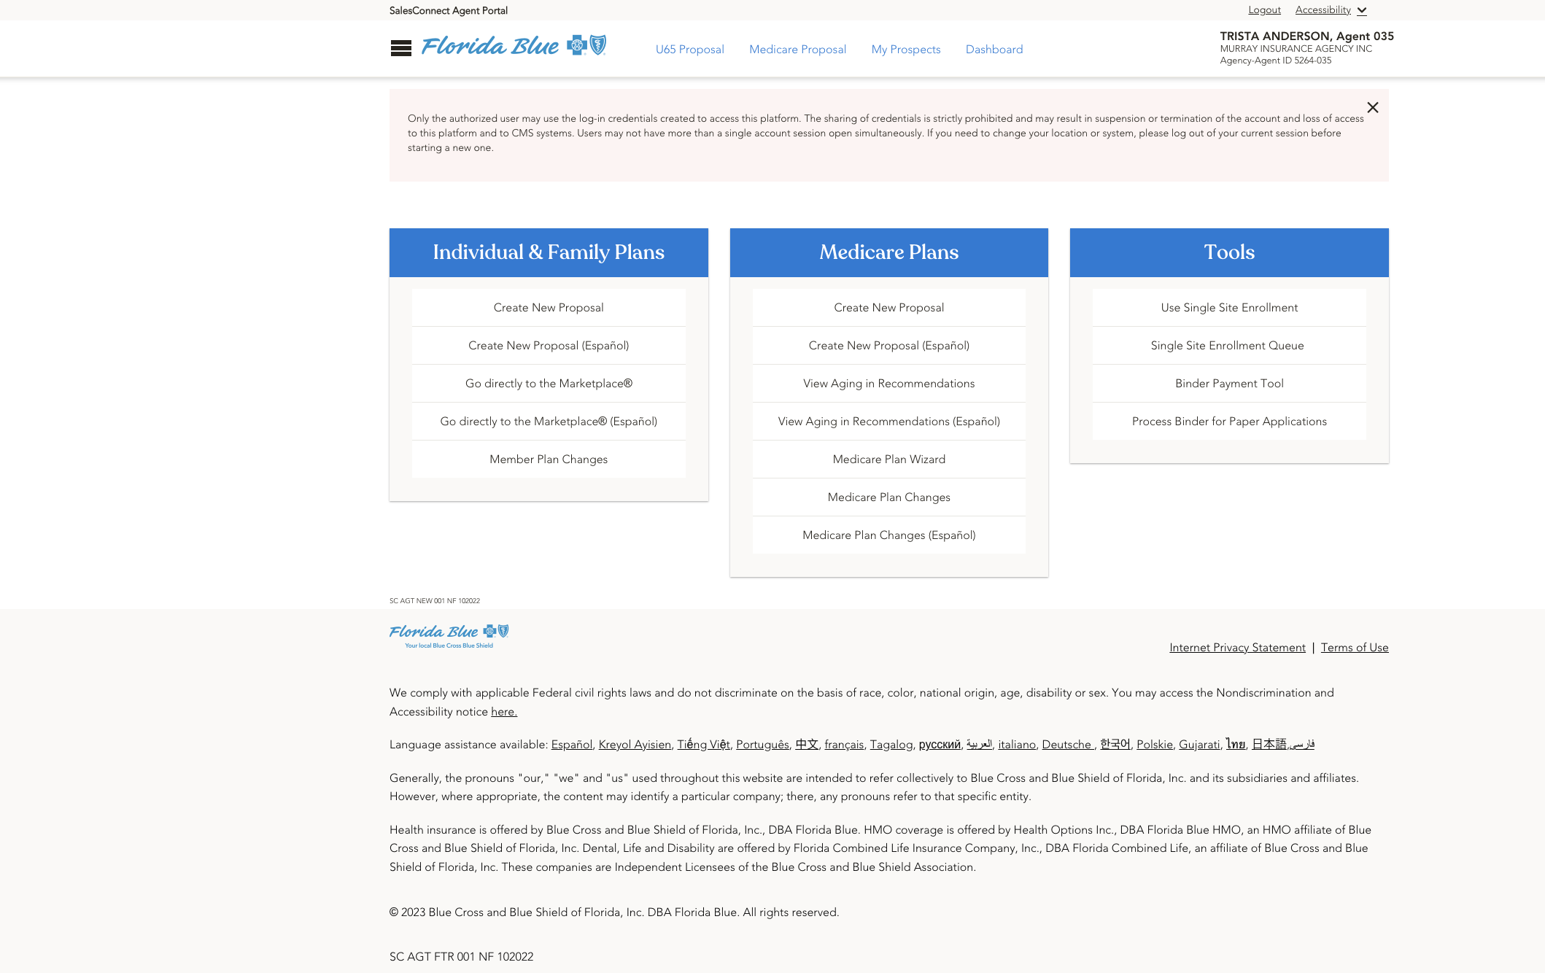
Select Plan Category
in this part of the process you need to select the product you are selling.
Florida Blue
Qualified Plans + USAble Life Products:
Off Marketplace plans
Marketplace Plans
Dental Plans
USAble Life Accident
USAble Life Critical Illness
USAble Life Hospital
Temporary
Medicare Plans:
Medicare Advantage
Medicare Prescription Drug
Medicare Supplemental
Change Existing Member Plan
Florida Health Care Plans
Off Marketplace plans
Marketplace Plans

Slide 5
For Individual & Family plans, Medicare, or Ancillary click on Quote Florida Blue.
This will re-direct you to the proposal process.
Ensure you have the basic information required to provide a quote.

Slide 6
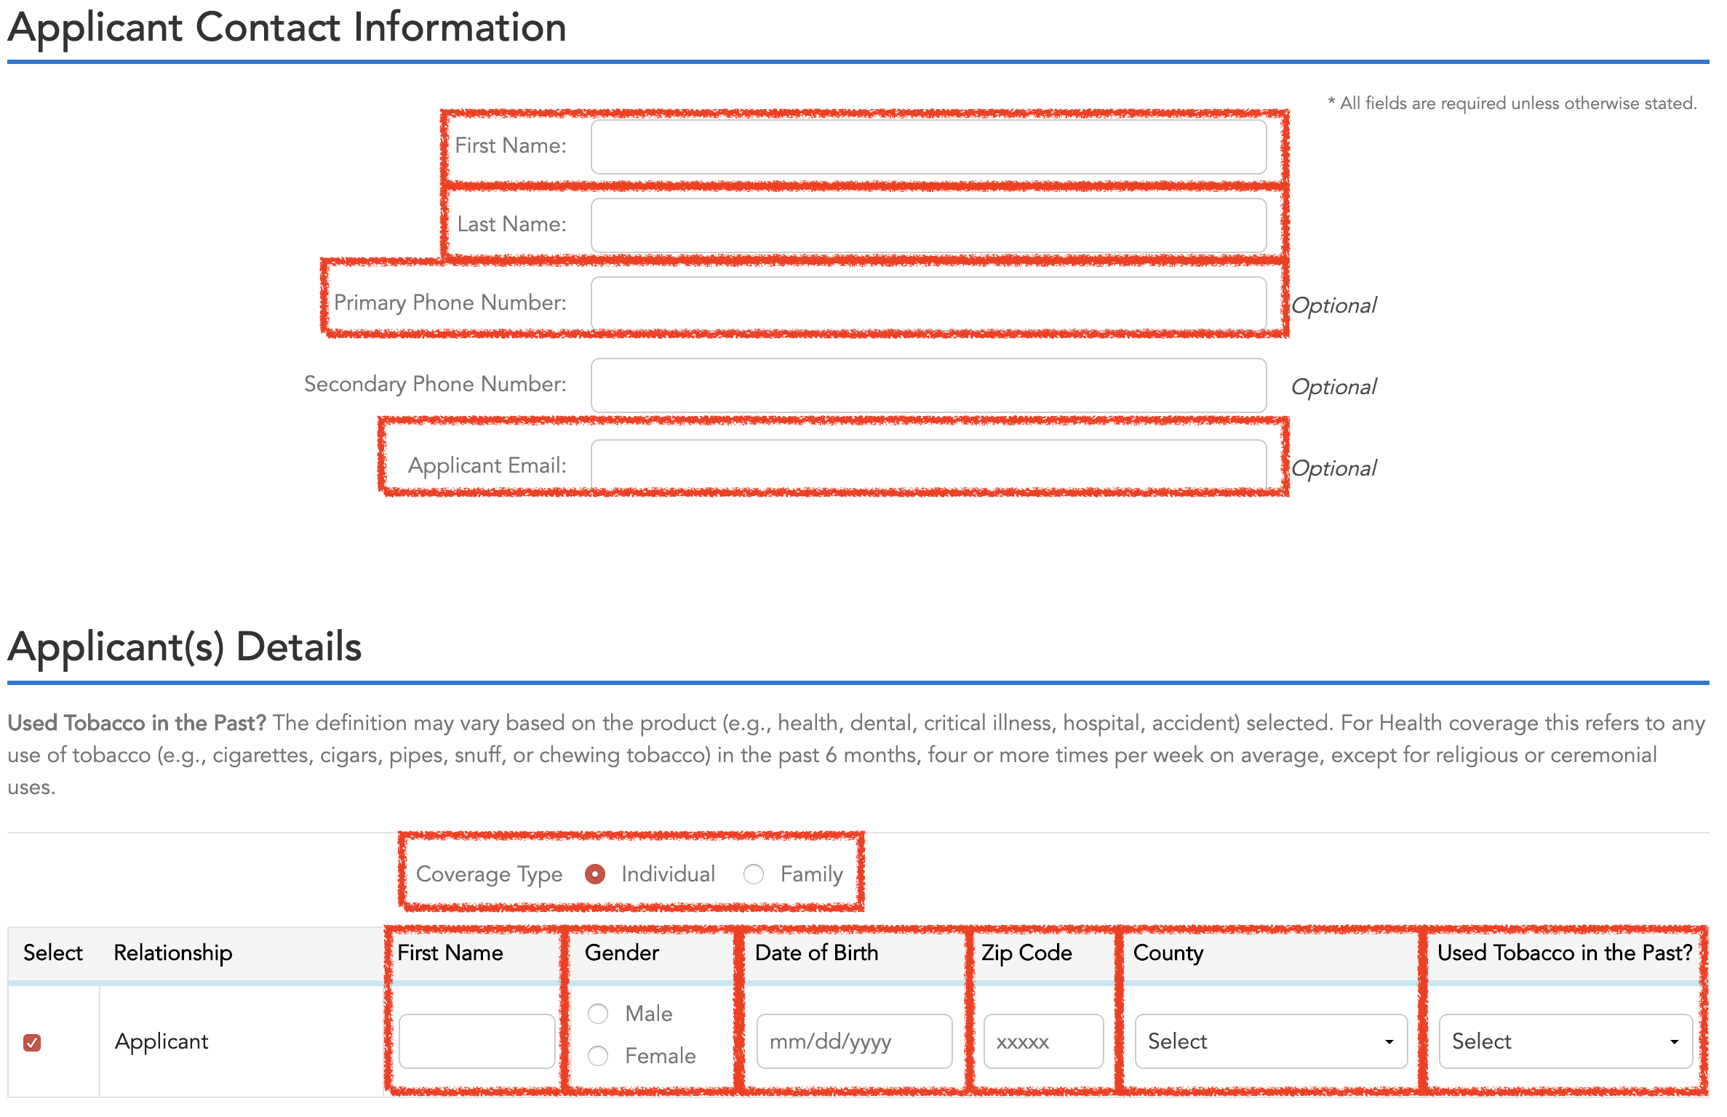
Basic Information to Quote:
First Name
Last Name
Phone Number
E-mail
Gender
Date of Birth
Zip Code
County
Used Tabaco in the past?
Checking for subsidy
Household size
Annual Household income
Household Tax status
Click on Check for Subsidy if the qualify for tax-credit.
Click Save and Continue if the don’t qualify for Subsidy or they want a quote off-marketplace.

Slide 7
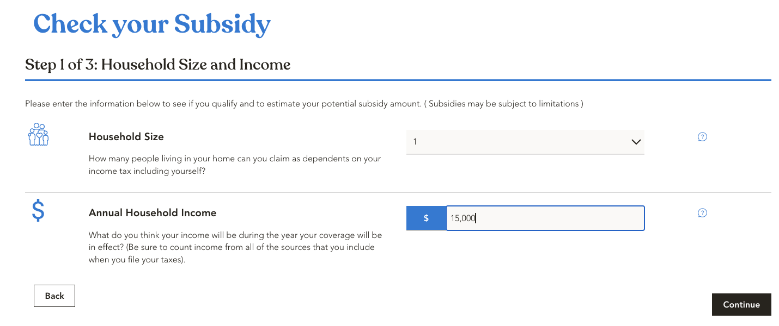
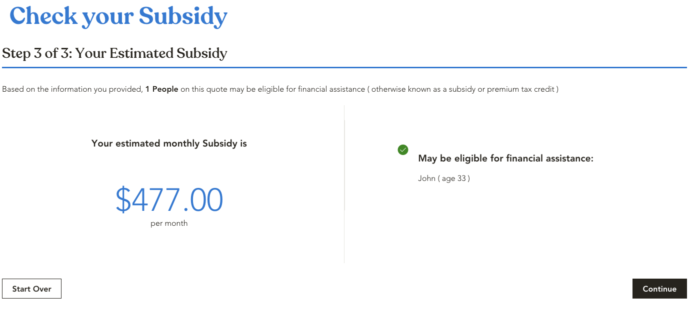
Insert the Household size, Income and Status. Click Continue.
Select if the prospect is a parent of a child under the age of 19. Click Continue.
The estimated subsidy will calculated based on the information provided.

Slide 8
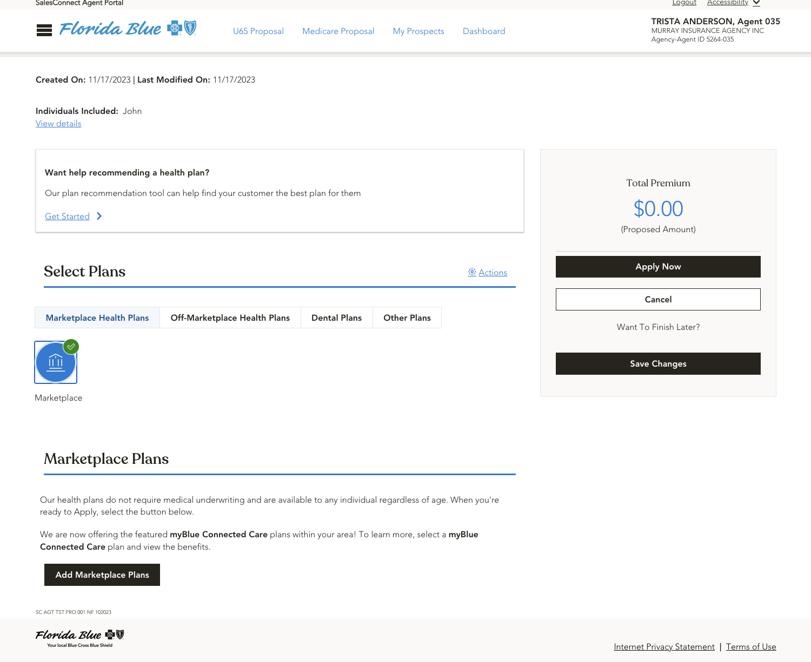
Once in the proposal page they will provide you with different options to quote with Florida Blue.
For Health Coverage select:
Marketplace or
Health
Once selected, 2 options will display.
1st option for Marketplace which will allow you to add the marketplace plans
2nd option for off-marketplace plans which will allow you to select off market plans. Please select the year of the plan (2023 or 2024).

Slide 9
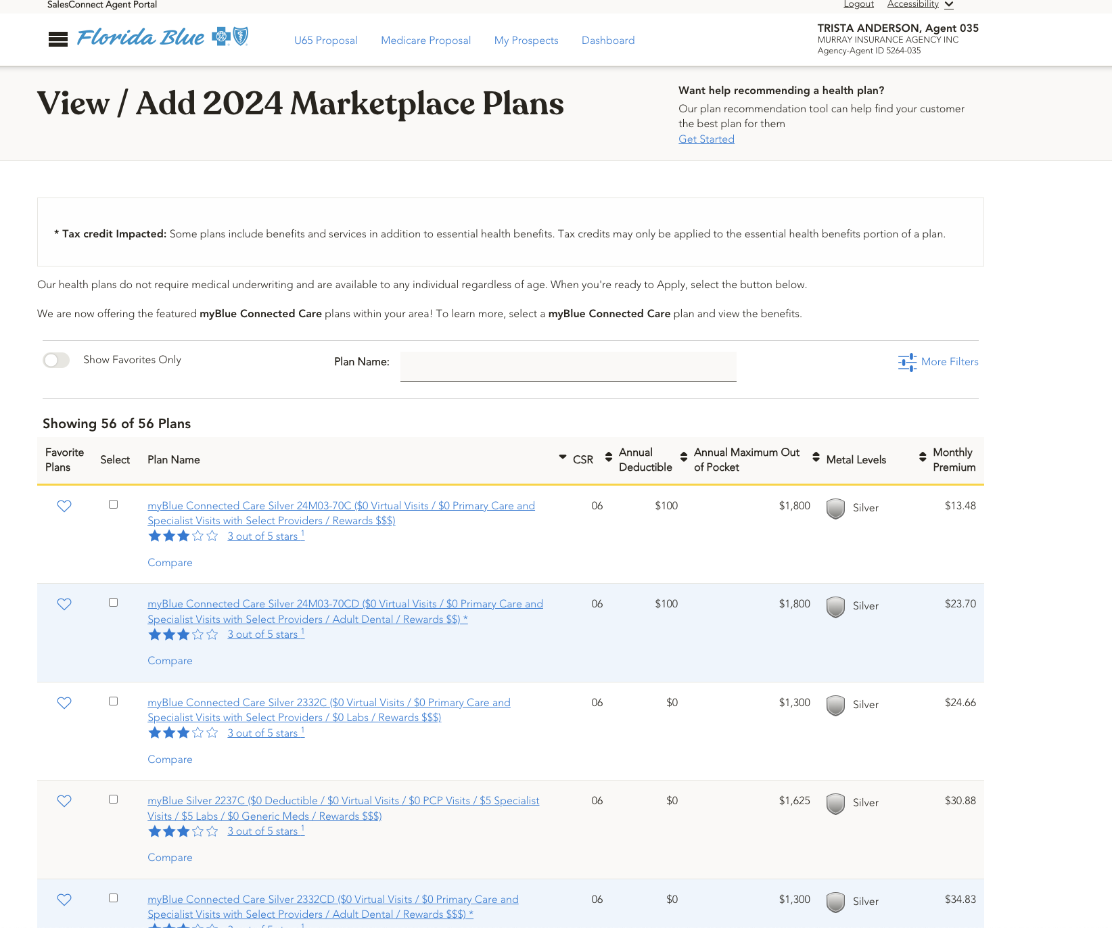
This is how it looks when you click on add Marketplace plan.
The Monthly Premiums reflected will include the estimated tax-credit which the prospect was eligible for.
In this view will provide you with the Annual Deductible, Annual Maximum Out-Of-Pocket and Metal Level.
Always ensure you select the plan that best suit the prospect needs.
Remember you will be able to select 3 plans to compare.

Slide 10
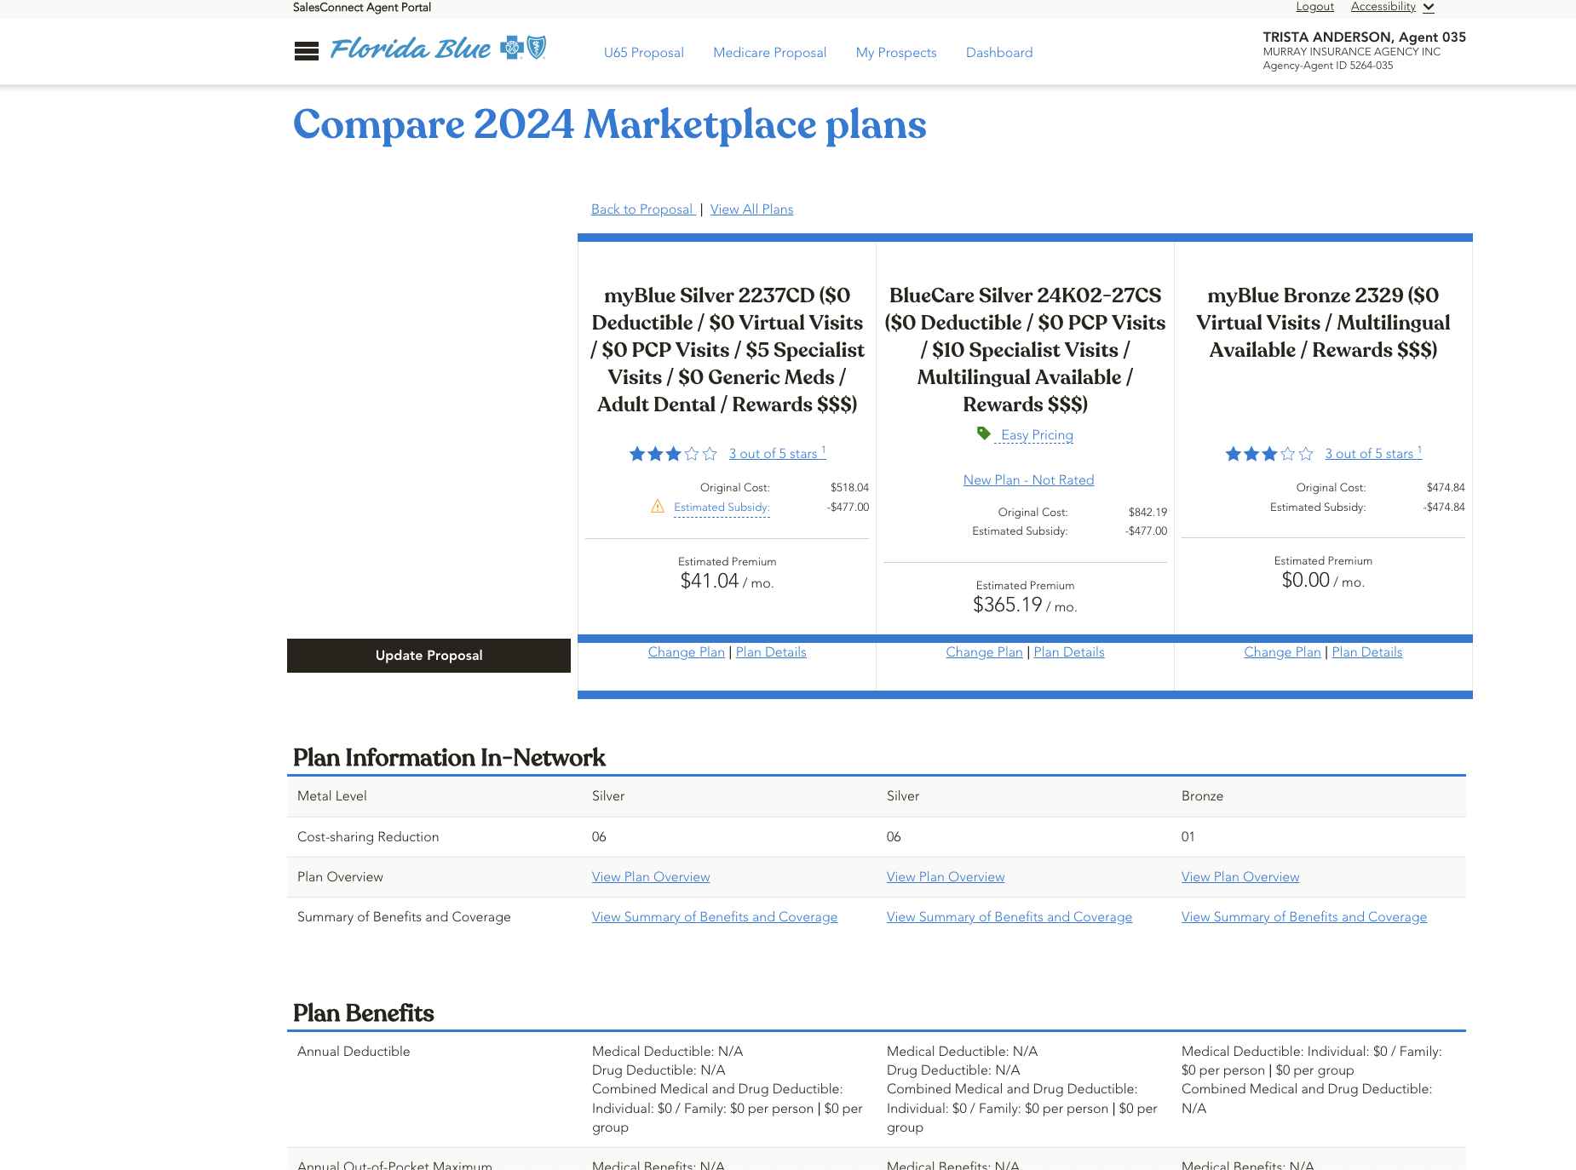
This is how the page will display the comparation of the 3 plans selected.
Also will give you the option to change the plan or get the plan details.
This tool is perfect at the time of comparing plan with the prospect since they will be able to look 3 plans side by side.

Slide 11
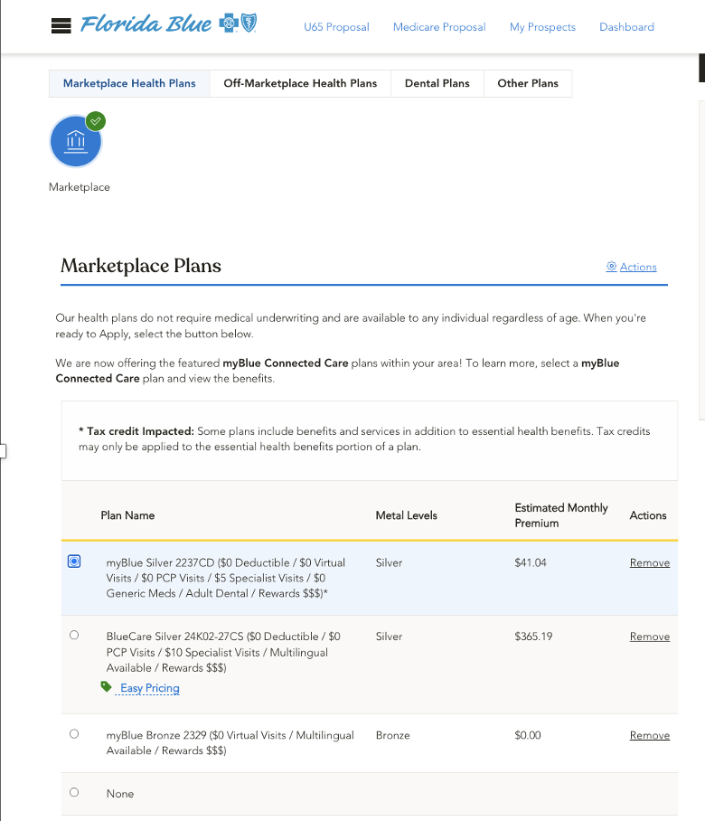
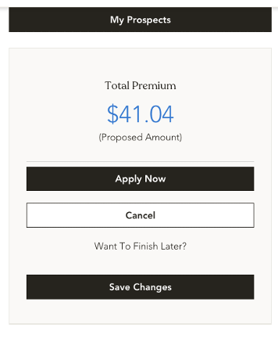
Once the prospect has decided on which plan they would like to enroll, 1st select the plan, 2nd click on apply now and 3rd select what type of enrollment you would like to proceed (Marketplace or Single Site Enrollment).

Slide 12
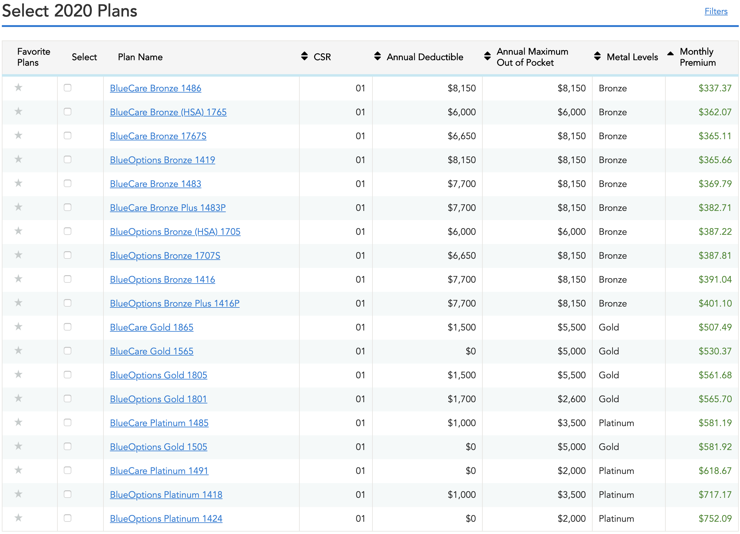
This is how Off-Marketplace will display.
In this view it will provide you with the Annual Deductible, Annual Maximum Out-Of-Pocket and Metal Level.
Always ensure you select the plan that best suit the prospect needs.
Remember you will be able to select 3 plans to compare.

Slide 13
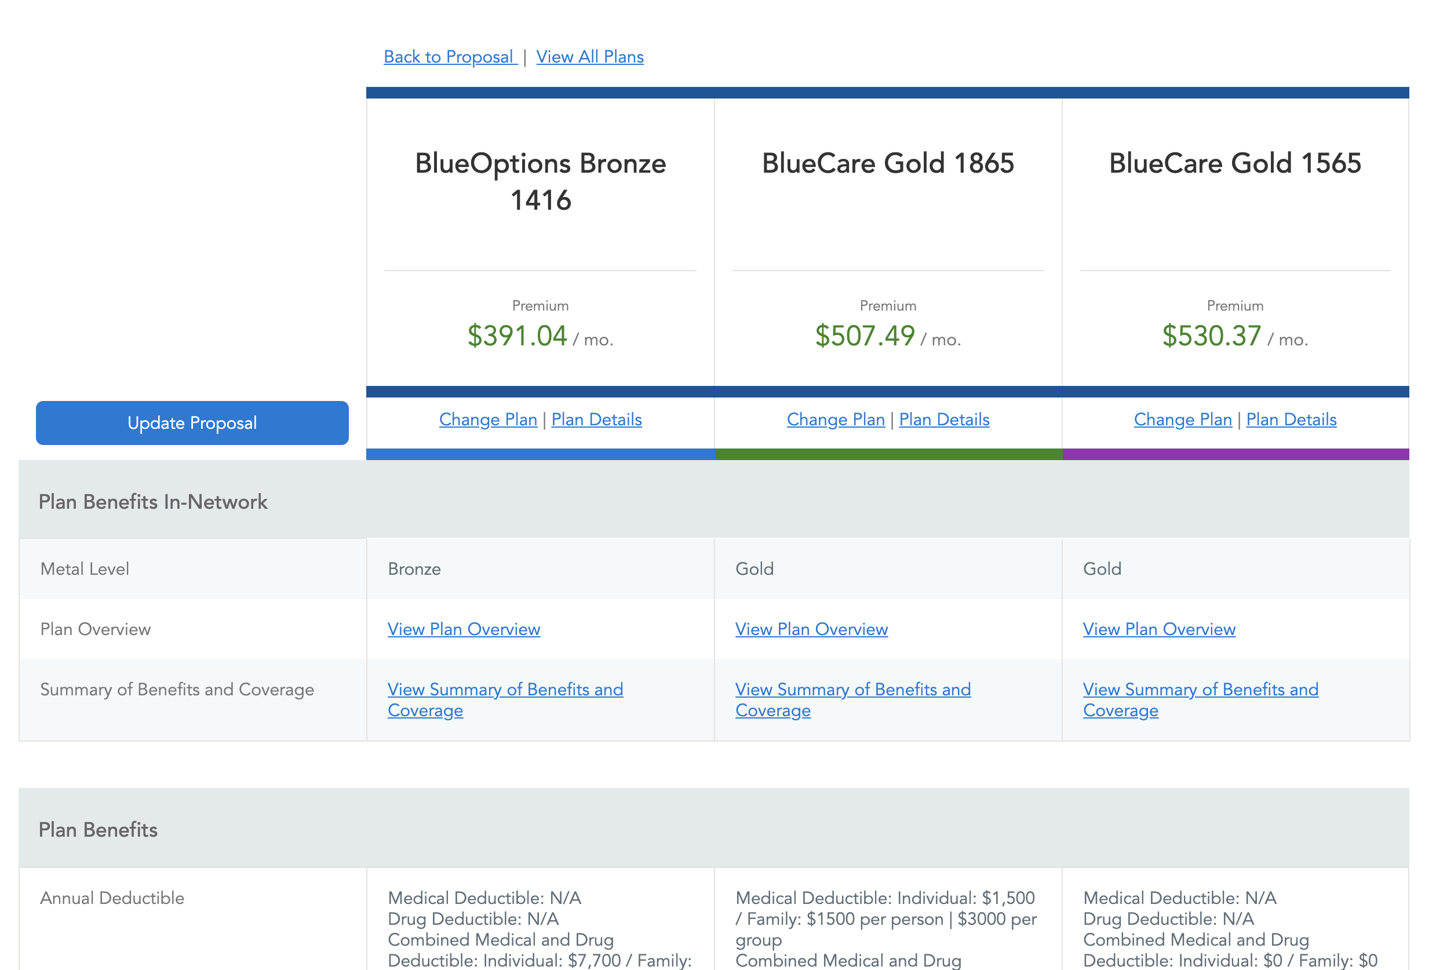
This is how the page will display the comparation of the 3 plans selected.
Also it will give you the option to change the plan, get the plan details, view plan overview and view summary of benefit and coverage.
This tool is perfect at the time of comparing plan with the prospect since they will be able to look 3 plans side by side.

Slide 14
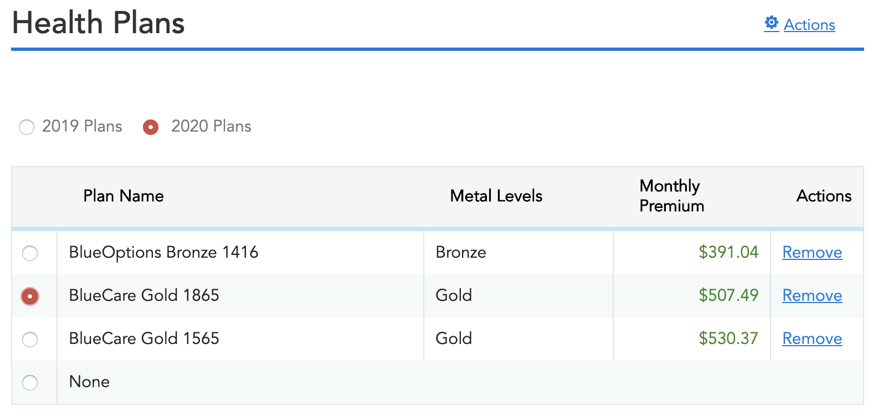
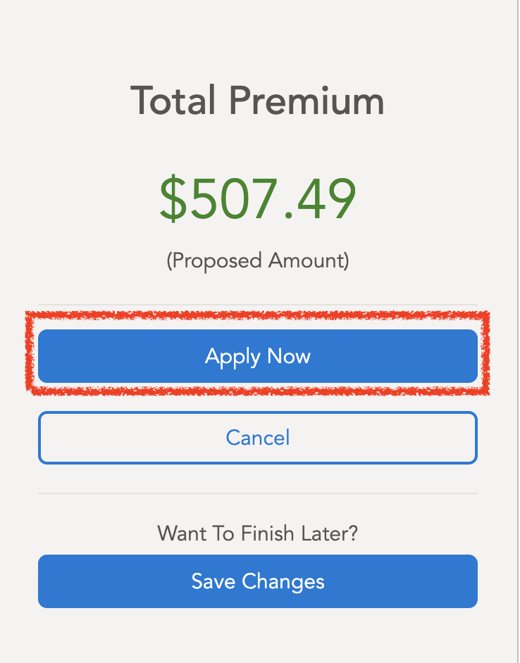
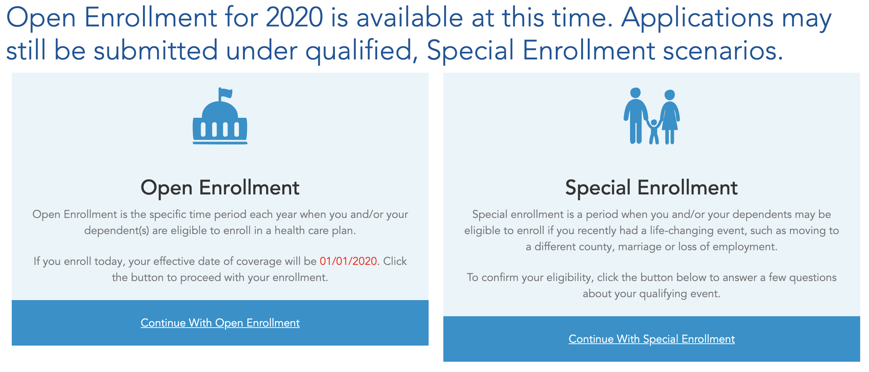
Once the prospect have decide on which plan he would like to enroll, 1st select the plan, 2nd click in apply now and 3rd select Election Period.
2020 plans need to be thought Open Enrollment.
2019 plans need a Special enrollment scenario.

Slide 15
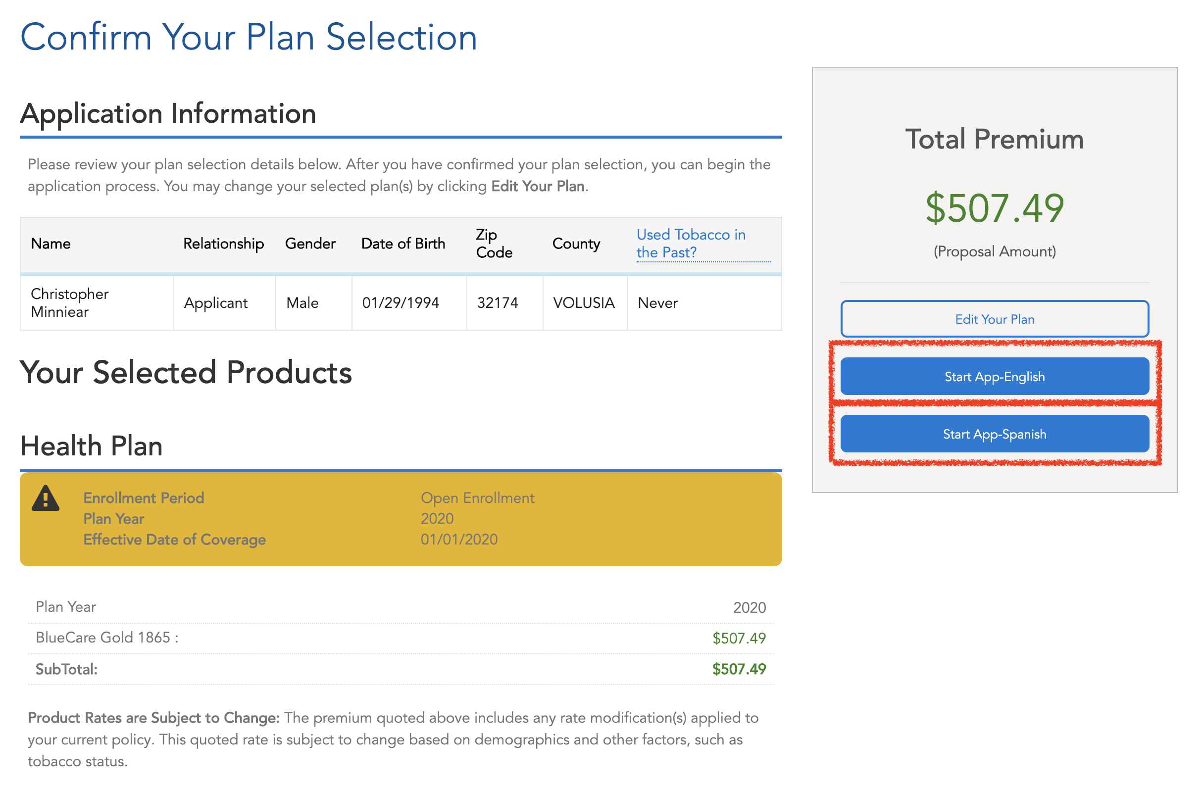
Once selected your Enrollment Period, the page will re-direct you to confirm the plan selection.
Please confirm the plan.
They will provide you with 2 options to proceed, one in Spanish and the other in English. Please select based on your criteria.

Slide 16
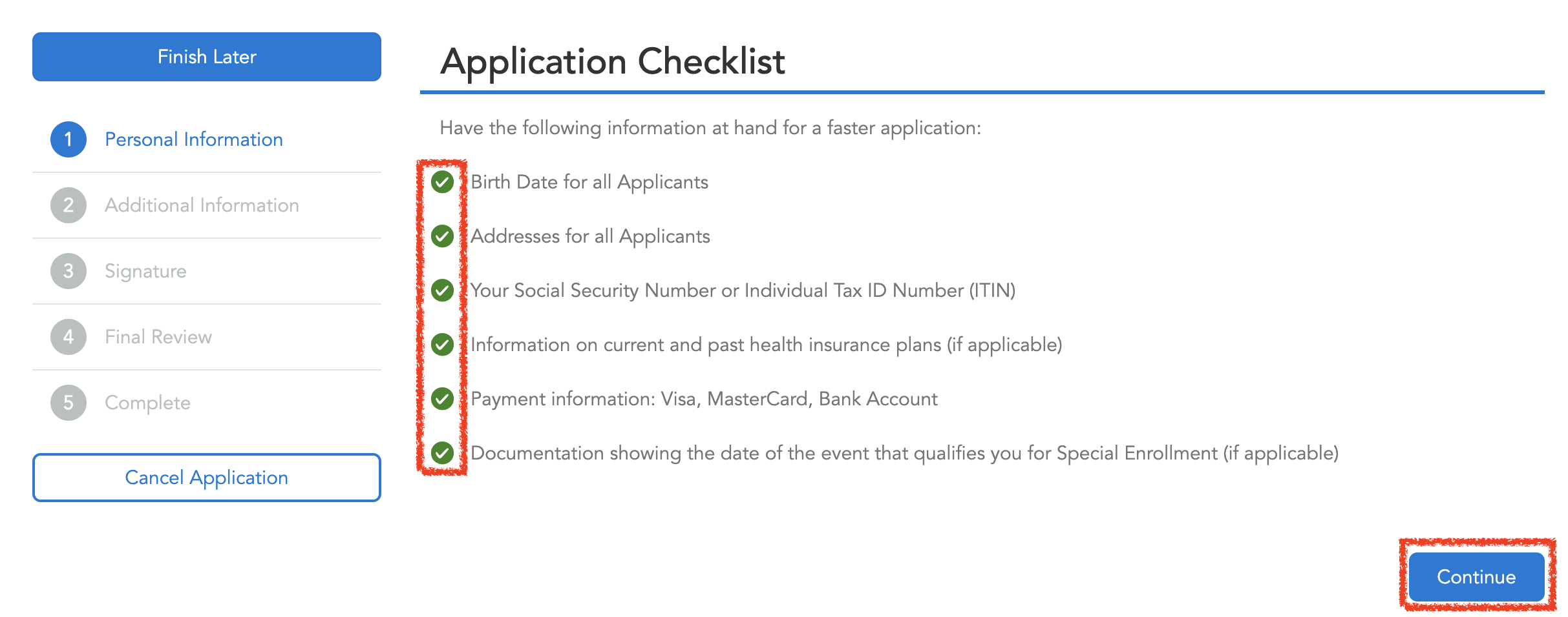
Please confirm with the prospect that he has the following information on hand:
Date of Birth for all applicants
Addresses for all applicants
Social Security or Individual Tax ID Number (ITIN)
Information on current and past health insurance plans (if applicable)
Payment information. (Visa, MasterCard, Back Account)
Documentation showing the date of the event that qualifies you for special enrollment (If applicable)

Slide 17
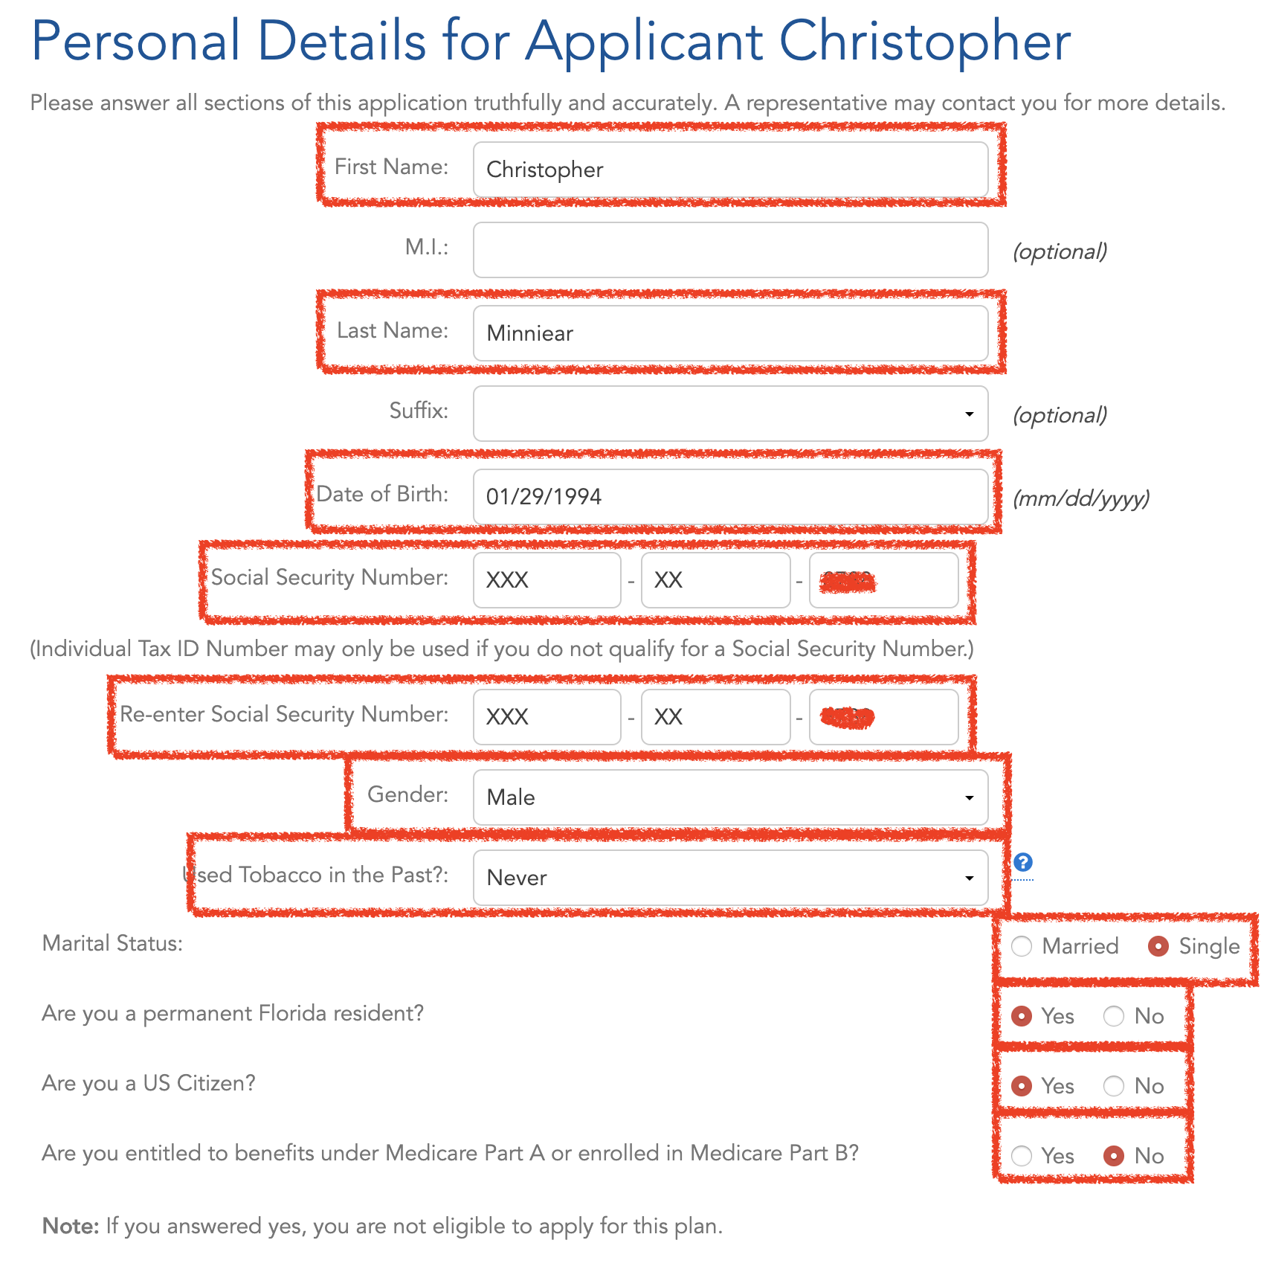
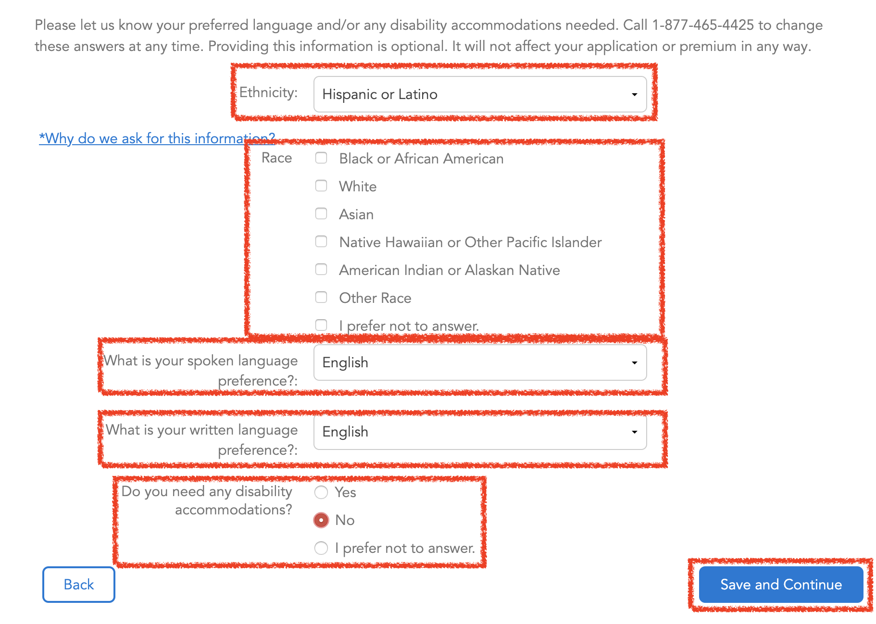
The following information needs to be added and confirmed:
Name
Date of Birth
Social Security Number
Gender
Tobacco in the past?
Marital Status
7. Florida Resident
8. US Citizen
9. Medicare Part A and B
10. Ethnicity
11. Spoken Language Preference
12. Written Language Preference
13. Disability

Slide 18
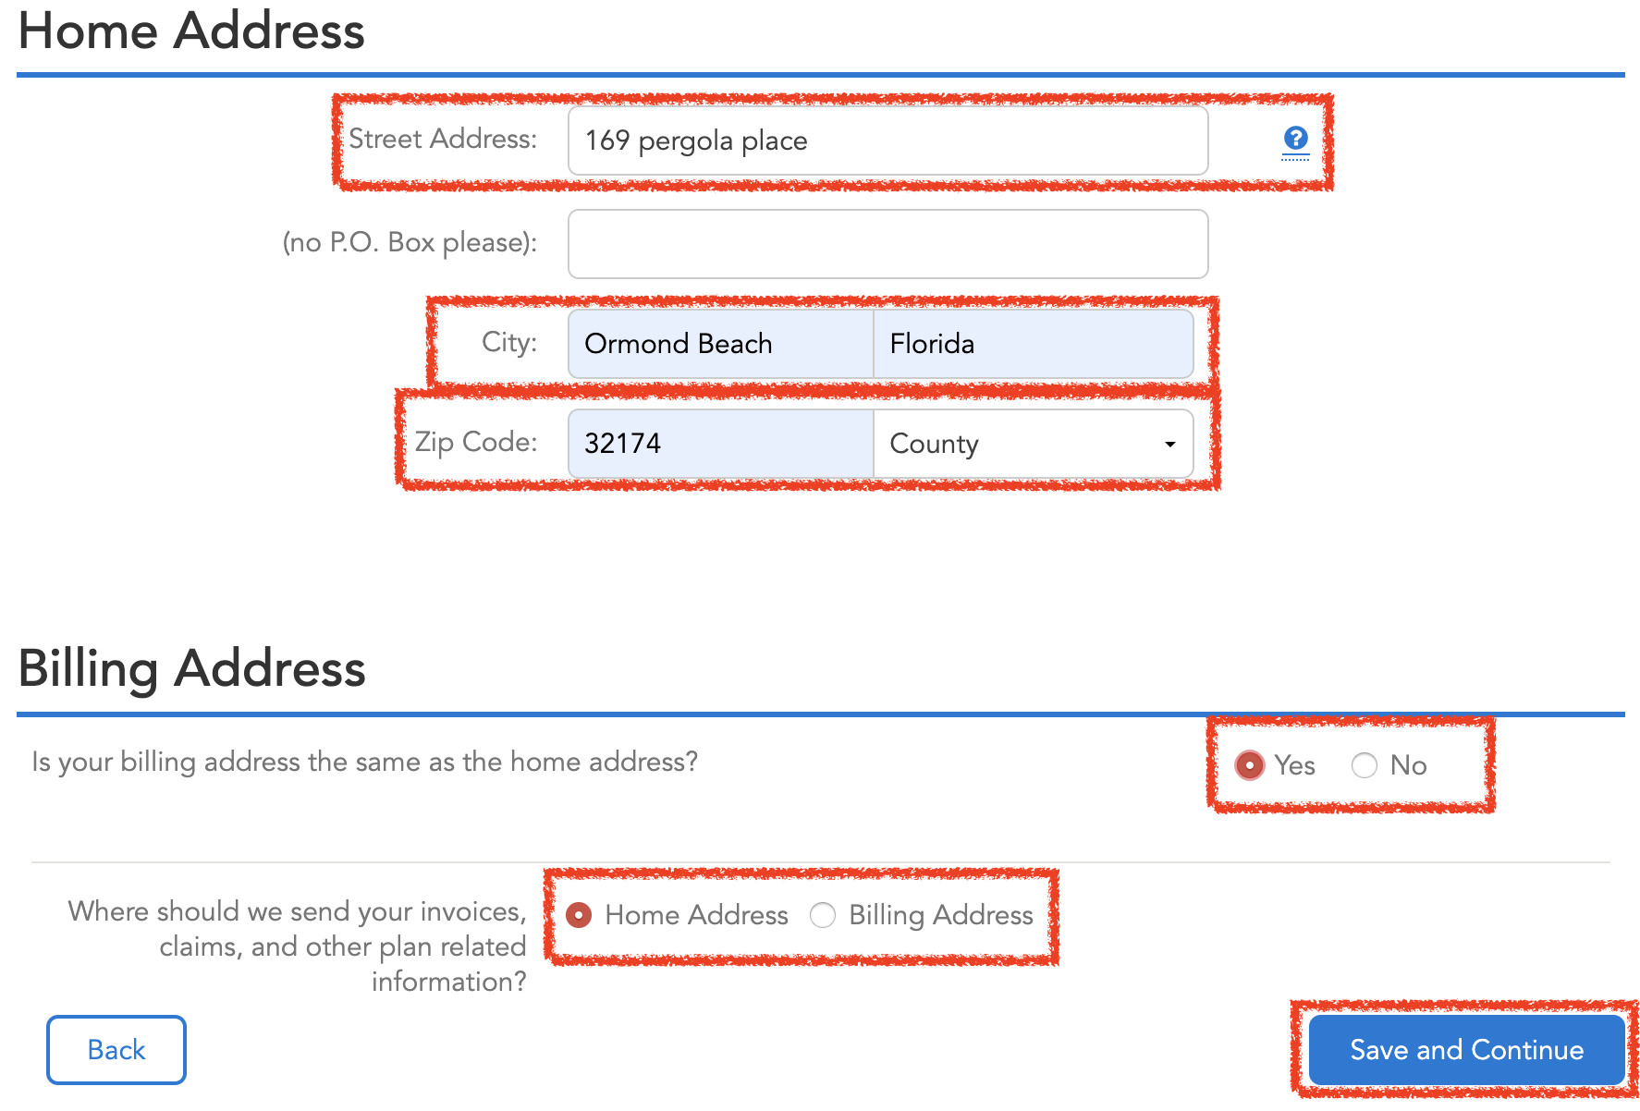
Home address will be the address where the prospect is currently residing.
Confirm the Billing Address is the same as home address or different.

Slide 19
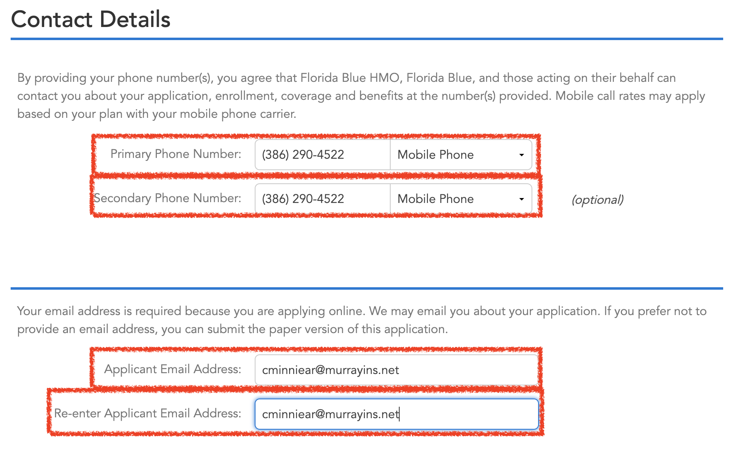
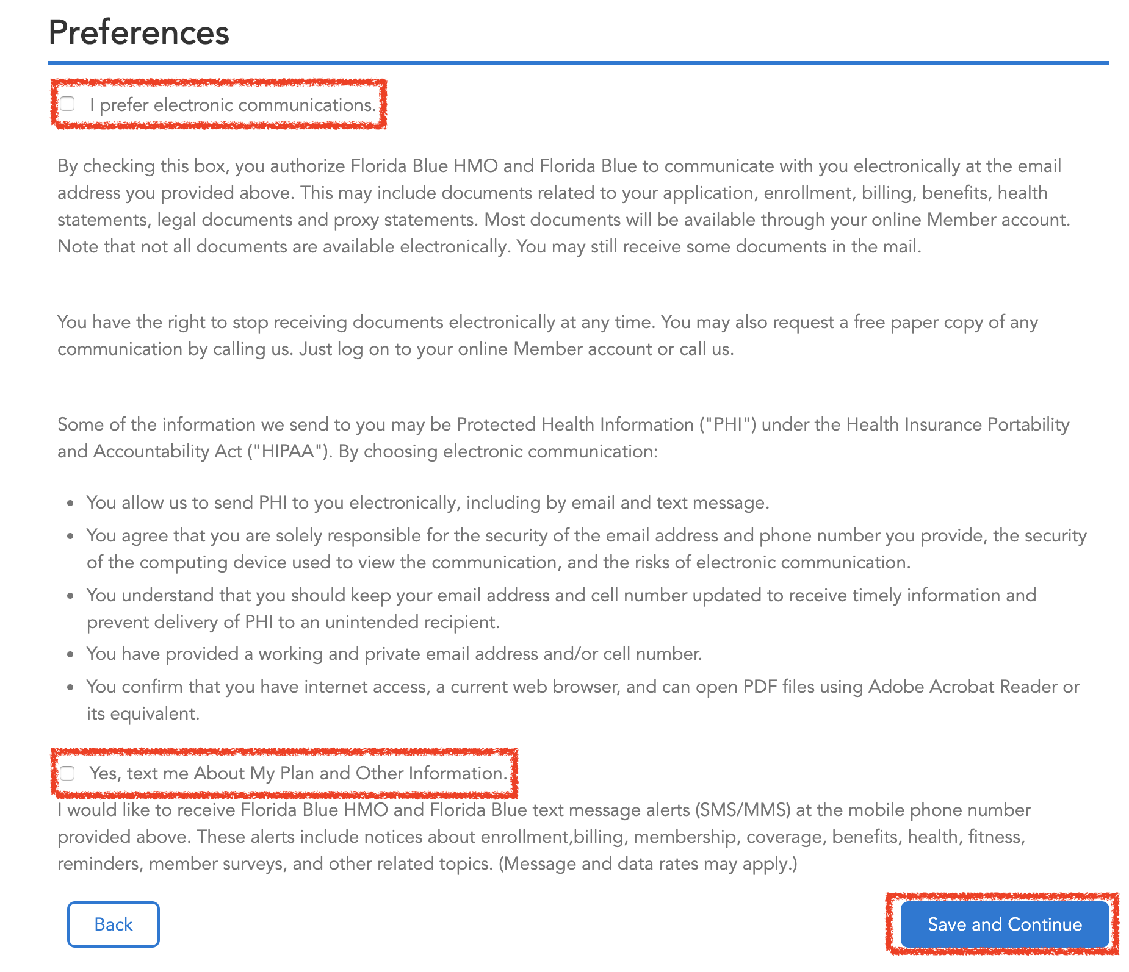
Contact Details
Primary Phone Number is a must, the secondary will be optional.
Confirm and re-enter the email address.
Preferences
With preferences we highly advice to select electronic communications since if they select text the Message and Data rates may apply causing extra cost to the prospect.

Slide 20
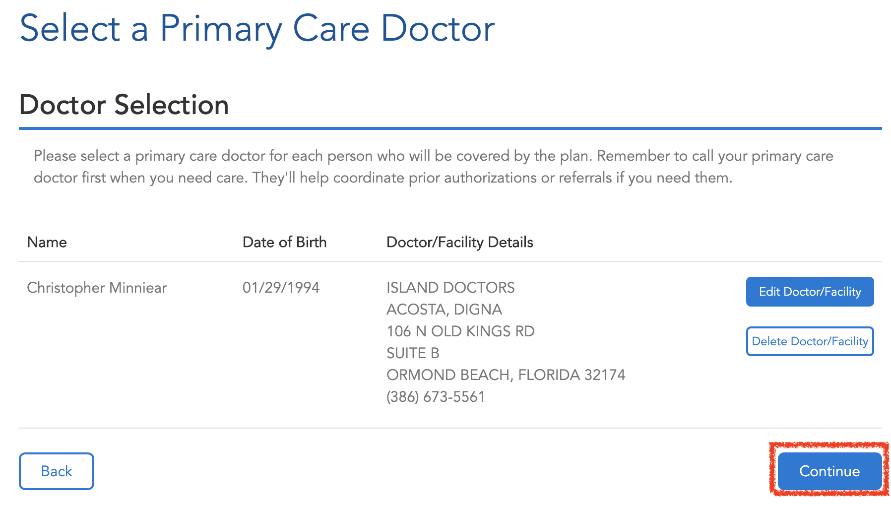
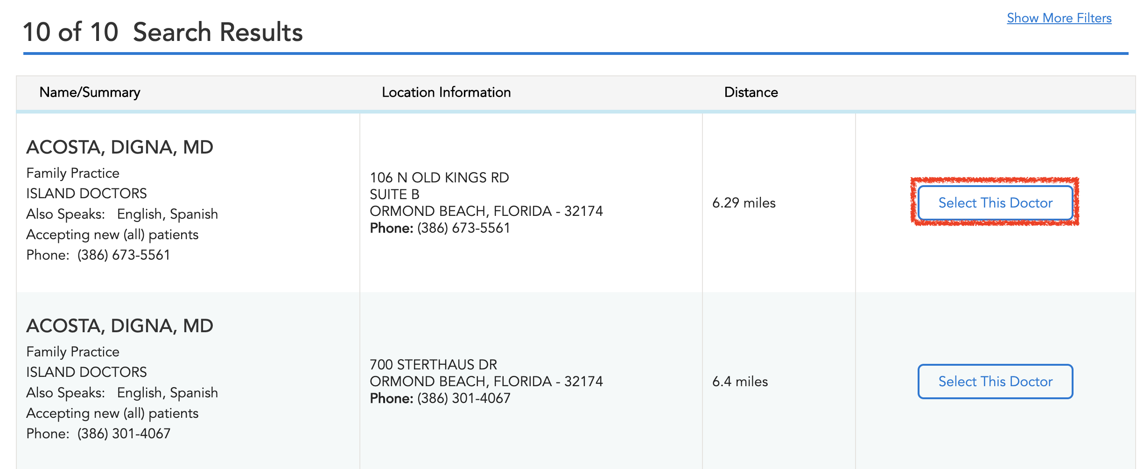
To select a Doctor 1st click on “Select Doctor/Facility”, 2nd Search for the doctor, 3rd Click on “Select This Doctor” and 4th click in Continue.

Slide 21
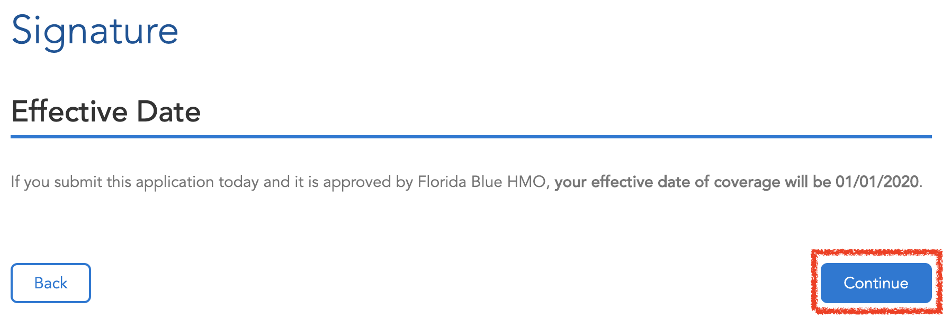
Other insurances information of a health coverage with Florida Blue.
Other insurance information of previous insurance coverage with another carrier in the las 24 month.
For 2020 plan effective date will be 01/01/2020.

Slide 22
In-Person
Use this submission type when the Agent and Applicant are sitting "in-person" or "face-to-face" and completing the application together.
Email
Use this submission type when the Agent completes the application up to the Agent Acknowledgements and then sends the enrollment to the Applicant via email to finish their acknowledgements and pay (if applicable).

Slide 23
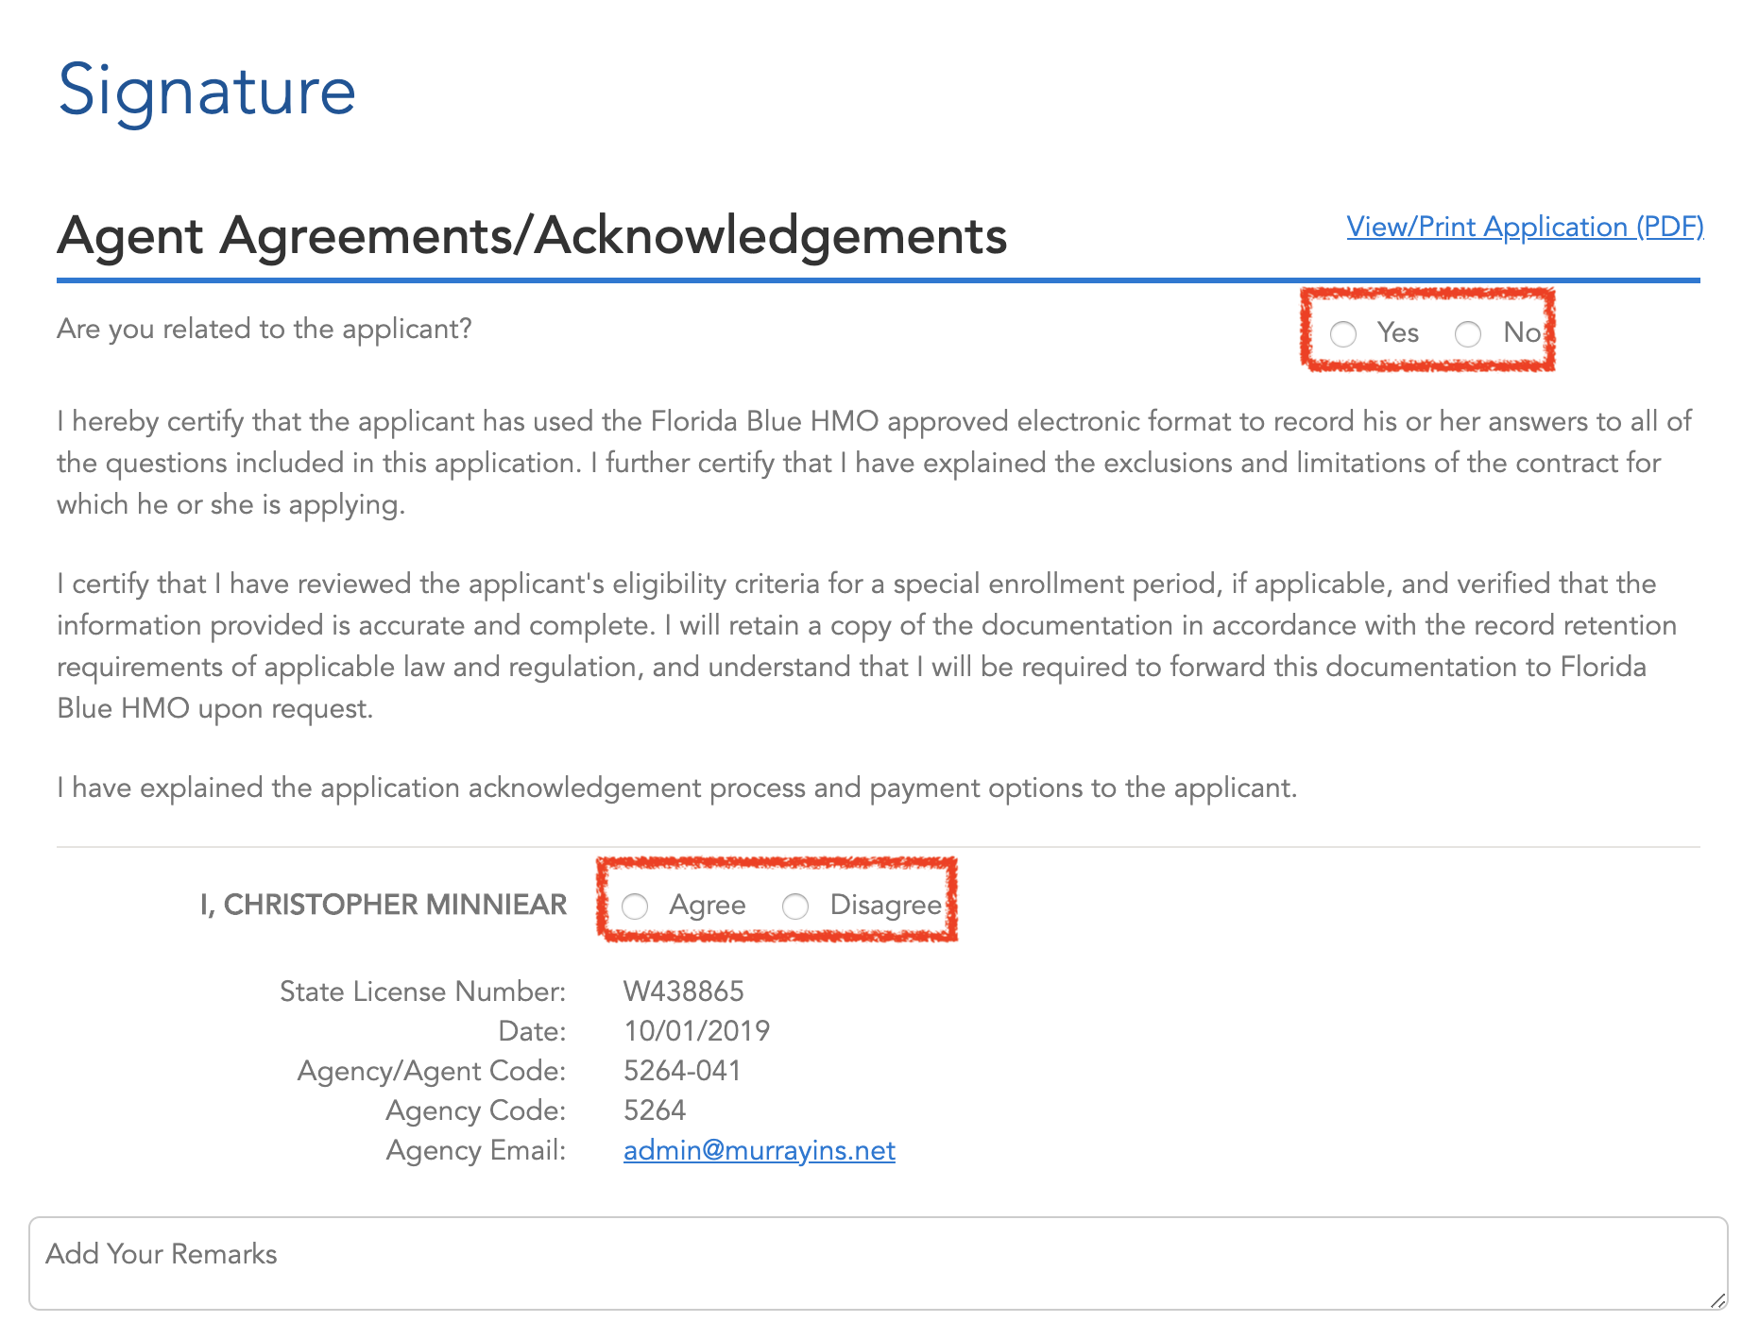
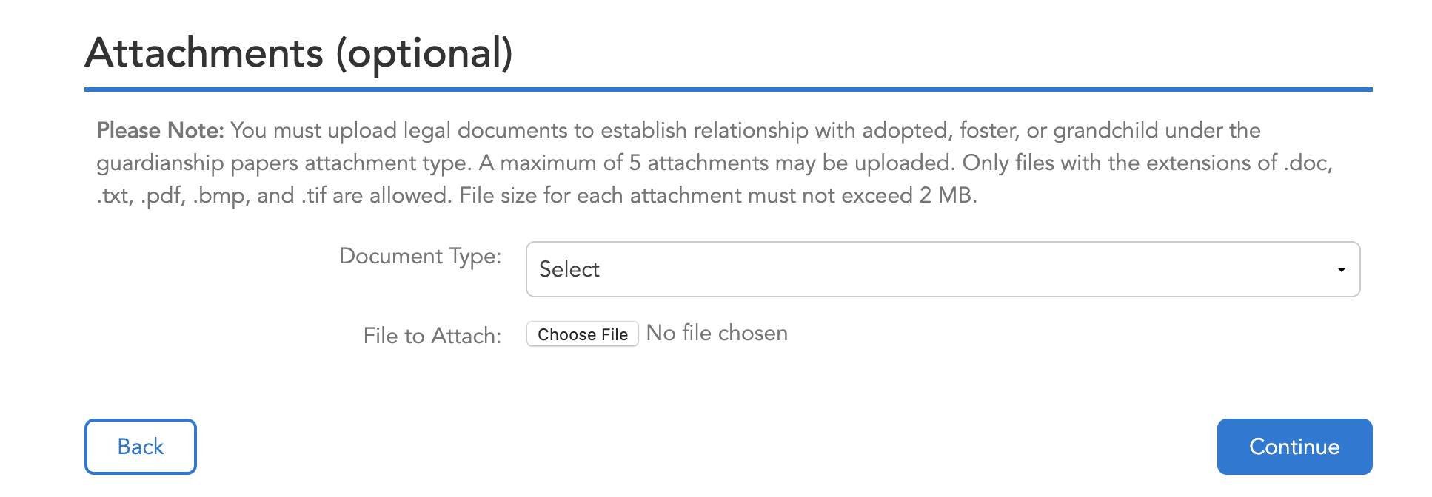
This sections is the Agent agreements and acknowledgements.
Select if you are related to the applicant yes or no.
Select if you agree or disagree with the statements above.
Attachments are optional.

Slide 24
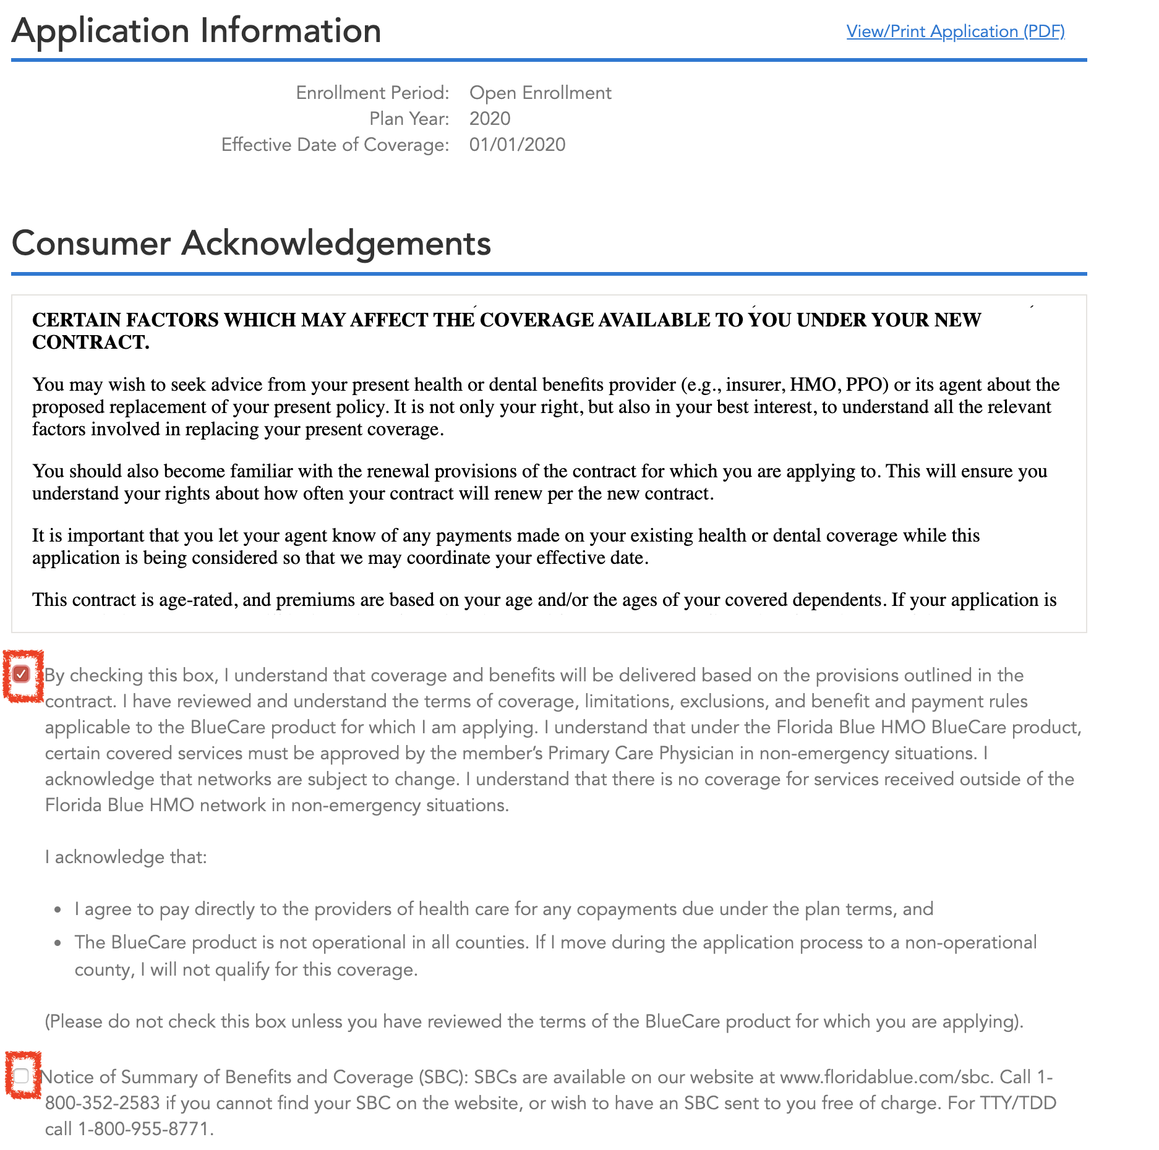
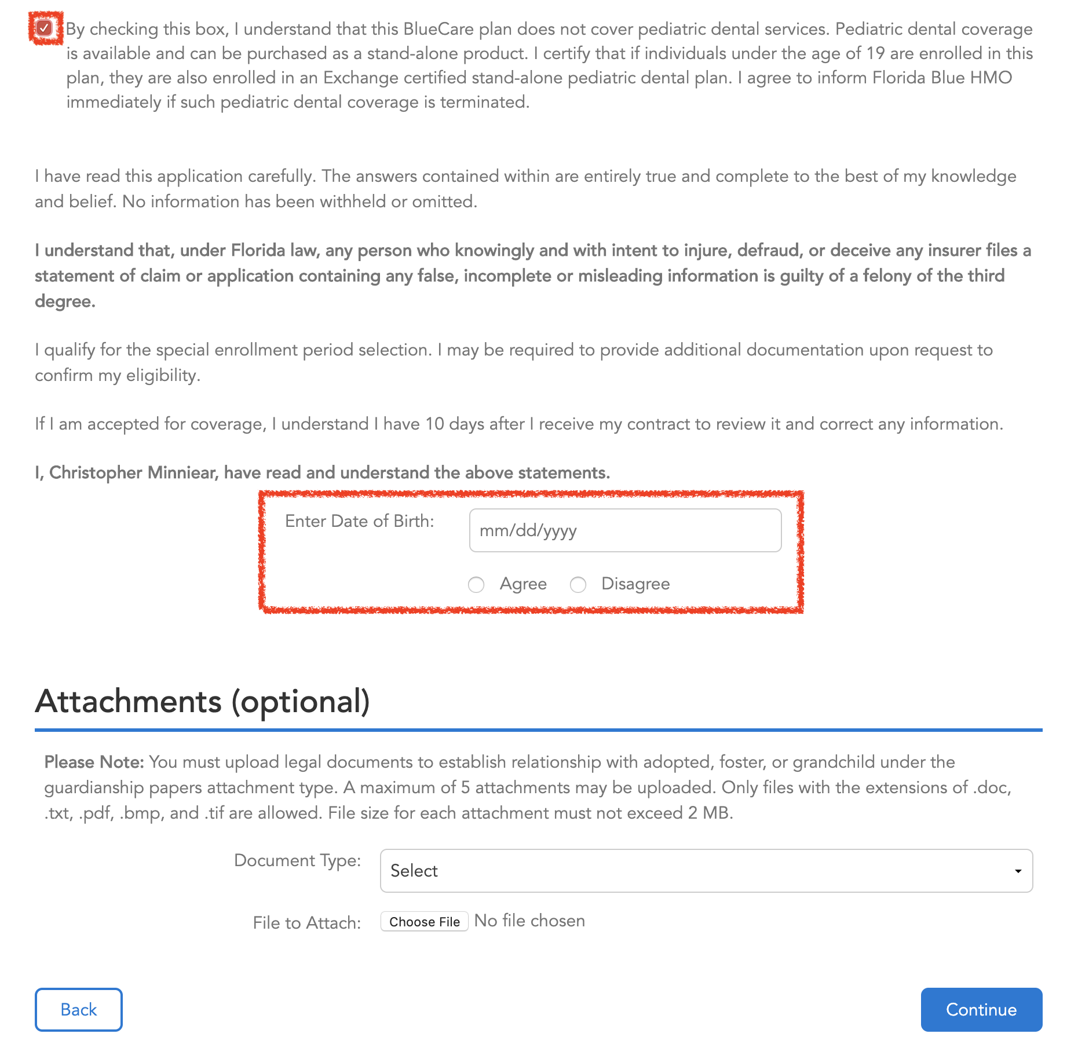
The applicant has to read the consumer acknowledgments and click on the little boxed once is completed the prospect has to enter the date of birth and click on agree as a electronic signature.

Slide 25
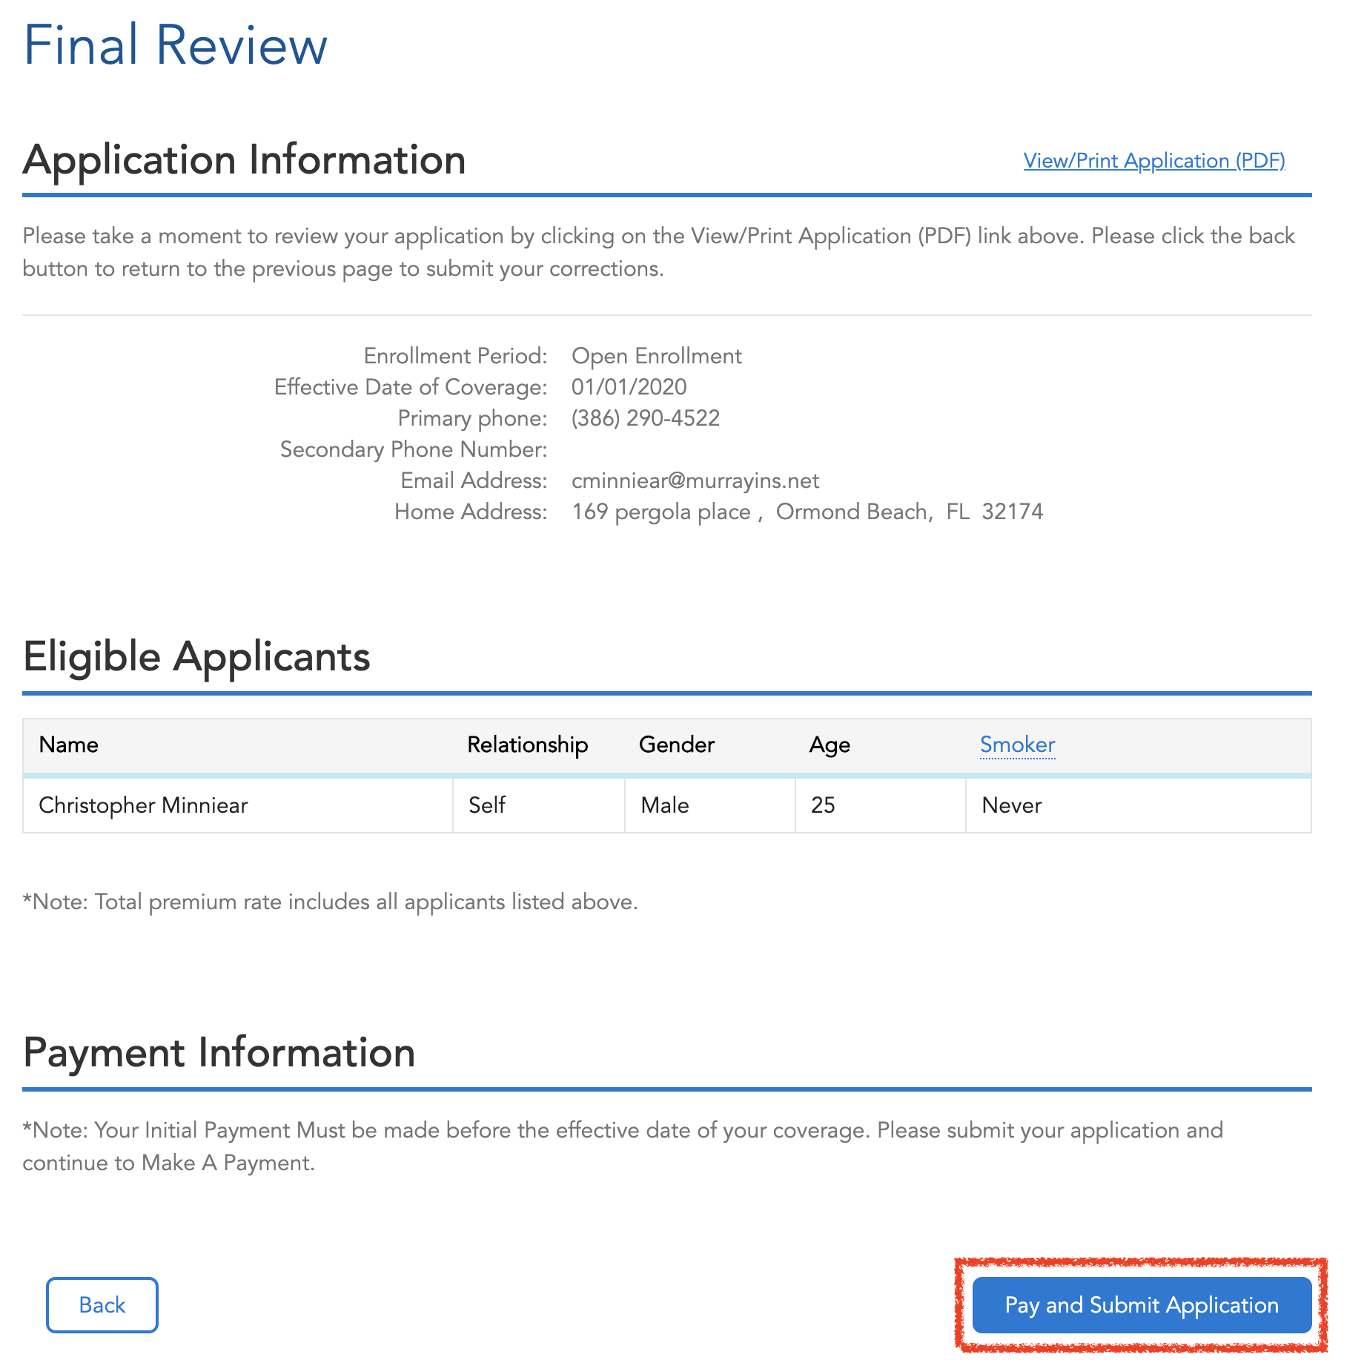
Final Review is very important to prevent any mistakes on the applications.
On the top-right corner you will find “View/print Application (PDF)” click in there to review the entire application. Once everything is ready to go, please click on “Pay and Submit Application”

Slide 26
S
M
A
R
T
YOUR SUPPORT TEAM
JUST A CALL/TEXT/EMAIL AWAY
STEPHANIE
Our Fearless Leader!
MELANIE
System and Reports
AgencyBloc Support
Lead generation
Operations
ADA
Spanish Trainer
Product Support
Certification Support
RENEE
All Marketing
Community Outreach
PCP Connection
TRISTA
Agent Trainer
Organizer
Lauren: Carrier appointments, Customer Support/Service Blue & FHCP U65.
Nancy: Group Guru! HELPS MAKE YOU STEADY INCOME!
Michaelene: C.F.O. – Money, Money, Money!
Lourdes: Reception of visitors and callers, all in office support,Event and Seminars

Slide 27
CONTACT NUMBERS/ EMAIL
Murray Office Team: 407-332-0909 Main Number 8:30am – 5:00pm EST
Lauren Savickas
407-227-5667 cell
lsavickas@murrayins.net
Melanie Livingstone
407-544-0121 cell
mlivingstone@murrayins.net
Ada Jimenez
407-760-5585 cell
ajimenez@murrayins.net
Trista Anderson
386-566-9625 cell
tanderson@murrayins.net
Renee Cline
407-421-3295 cell
rcline@murrayins.net
Stephanie Aldridge
407-716-7312 cell
saldridge@murrayins.net
Nancy Kemper
407-489-2334 cell
nkemper@murrayins.net
Michaelene Criswell
mcriswell@murrayins.net
Lourdes Pagan
407-332-0303
LPAGAN@murrayins.net
STILL DON’T KNOW WHO TO ASK? Call Melanie, she will direct you to the right person!

Slide 28
Any Questions????

