Slide 1
DENTAL PLANS

Slide 2

BlueDental Plans
Qualified Plans
BlueDental Copayment
BlueDental Choice
Non-Qualified Plan
BlueDental Care Prepaid FI315
2

Slide 3
PPO DENTAL
Plans and Benefits
3

Slide 4


FCL Q and QF Dental Plans
Q Plan
Pediatric
coverage
QF Plan
Pediatric and
adult coverage
4

Slide 5
BlueDental (Pediatric)
Choice & Copayment Plans
 | CHOICE |  | COPAYMENT
 | In-Network | Out-of-Network | In-Network | Out-of-Network
Deductible | $50 (only basic and major) |  | $25 (preventative, basic, major)
Annual Maximum | Unlimited
Preventive Services | 100% | 80% | See Schedule | 80%
Basic Services | 80% | 60% |  | 60%
Major Services | 50% | 30% |  | 40%
Waiting Period | No Waiting Period
Out of Pocket Maximum | $350 one child / $700 more than one child
5

Slide 6
BlueDental (Adult)
Choice & Copayment Plans
 | CHOICE |  | COPAYMENT
 | In-Network | Out-of-Network | In-Network | Out-of-Network
Deductible | $50
Annual Maximum | $1,000
Preventive Services | 100% | 80% | See Schedule | 80%
Basic Services | 80% | 60% |  | 60%
Major Services | 50% | 30% |  | 40%
Waiting Period | Six-month waiting period for basic and major services. The waiting period can be waived with proof of prior continuous comparable dental insurance coverage.
Rollover | Included
6

Slide 7
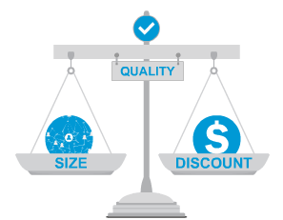
The #1 Dental Network in Florida
Our Copay and Choice PPO networks lead the industry as #1 and #2 in effective discounts in Florida,¹ providing employers with the dental networks that are most successful at saving them money.
The most important measure of a network
Effective discounts reflect the savings when strong discounts are coupled with high in-network utilization
Power behind our results is a smarter network with the right number of the right dentists—at the right discounts
What are the results?
Lower premiums and out-of-pocket costs for employers and consumers
Minimizes future rate increases
Size matters, too: 6,000 Unique Locations in Florida and over 70,000 nationwide
¹ Ruark Consulting, “2016 PPO Network Study,” 2017. Other participants in the study include Delta, MetLife, Guardian, Aetna, Cigna, United Healthcare, and others.
7

Slide 8
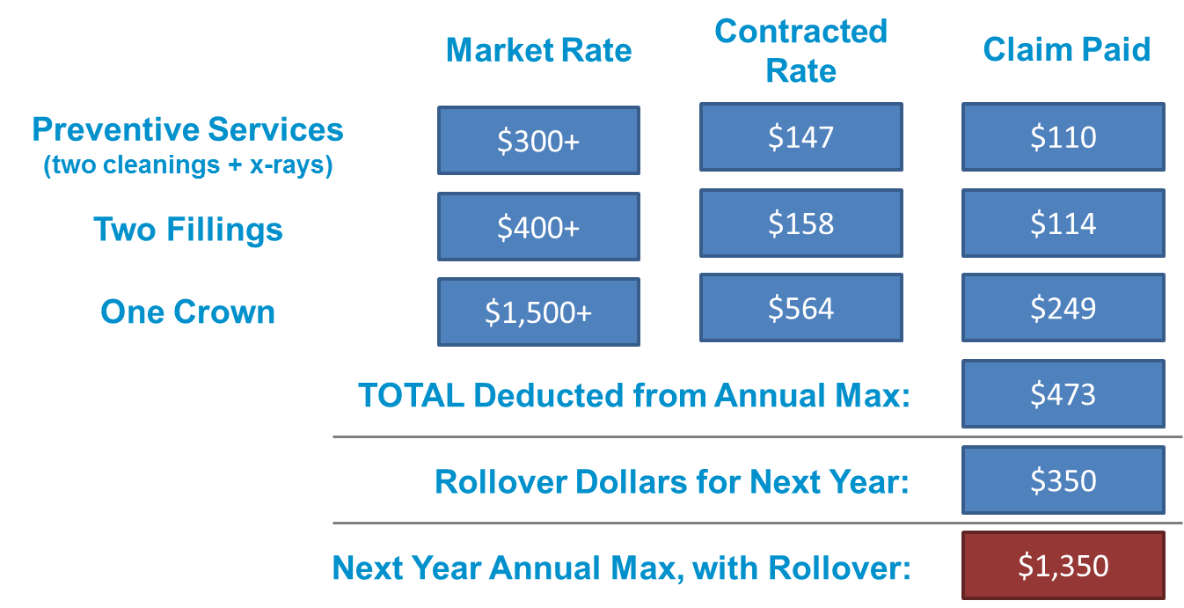
Our Benefits Go Further with Effective Discounts + Maximum Rollover
Our annual maximum goes much further than that of other carriers
$1,000 annual maximum plan
8

Slide 9
Maximum Rollover
With our plans, members’ unused benefit dollars from one year are “rolled over” to the next year
How does it work?
On average, members have major services every 3-5 years
Only a small percentage of members actually exceed the annual maximum
By Year 3, a qualifying member has the opportunity to double their annual maximum
Members can use the additional dollars to schedule higher out-of-pocket services in advance, providing added security for an unexpected issue
Rollover example: Based on $1,000 annual maximum benefit
Maximum plan expenditure in a given plan year to qualify for the rollover benefit | $500
Amount that gets rolled over to the next plan year for those who qualify | $350
Year 2 annual maximum benefit ($1,000 + $350) for members qualifying for rollover in Year 1 | $1,350
Year 3 annual maximum benefit ($1,000 + $350 + $350) for members qualifying for rollover in Year 1 and 2 | $1,700
Total possible annual maximum benefit after 3 years (the amount a member can accumulate after 3 years of rollover is capped at $1,000) | $2,000
9

Slide 10
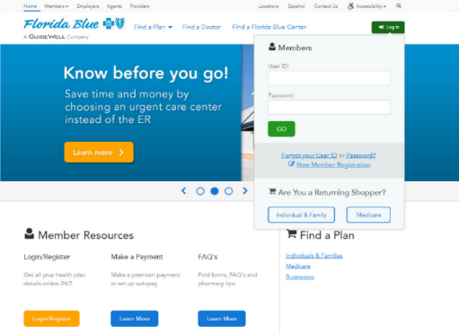
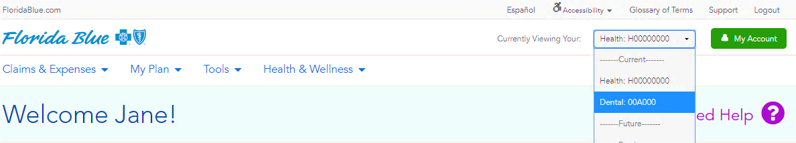
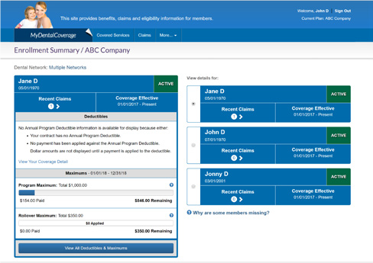
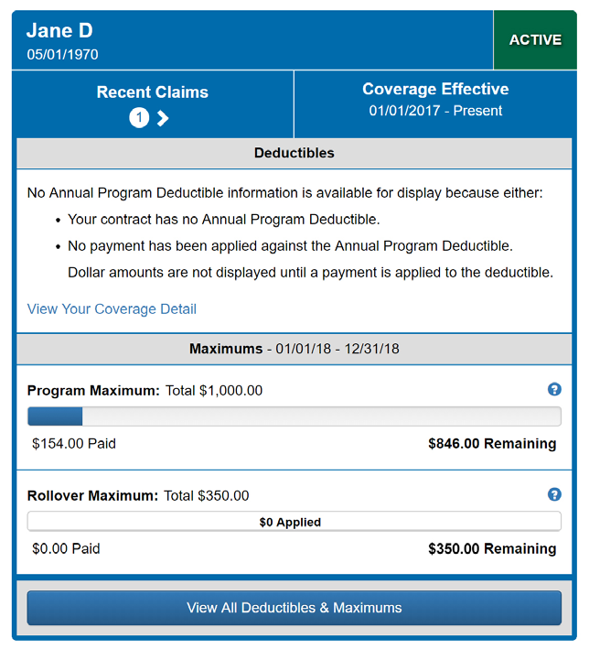
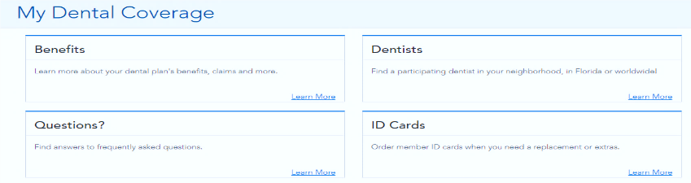
Check Maximum Rollover Balance
1
2
Log in or create an account at www.FloridaBlue.com.
Click the drop down menu in the top right corner and select “Dental.”
Here you can print or order a new ID card, and get answers to questions. Click “Learn More” in the benefits section to access the benefits portal.
3
4
Find each covered member. Deductibles and the amount of the annual maximum used. Rollover dollars earned and used are displayed at the bottom of the section.

Slide 11
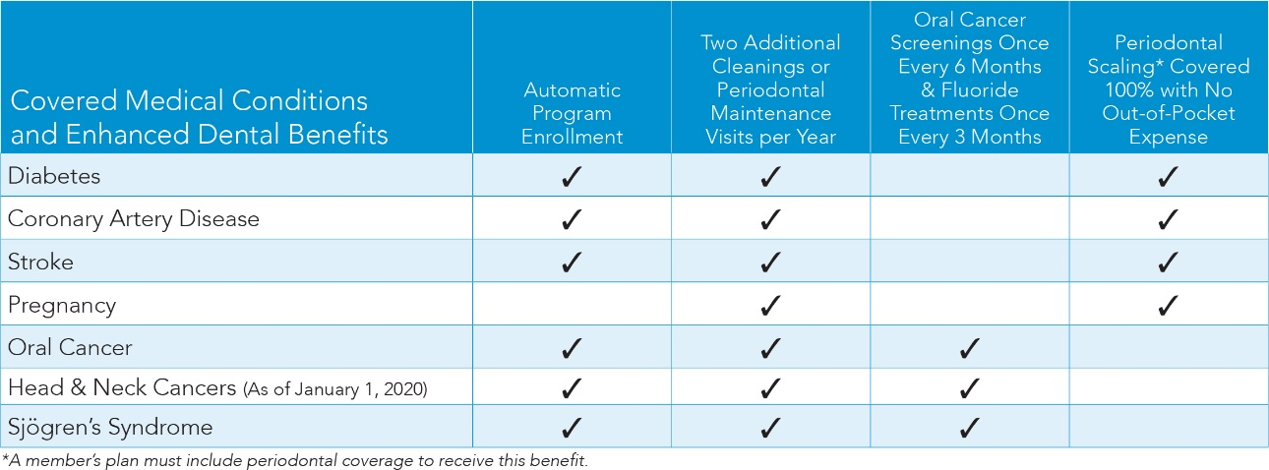
Oral Health for Overall HealthSM
Medical cost savings plus enhanced dental benefits
Studies show significantly lower medical costs for members who use their preventive or periodontal dental services versus those who do not.¹ This can lead to substantial savings for employers and members!
$889 extra benefits per year for average Florida adult with diabetes,
coronary artery disease, or pregnancy
$1,110 extra benefits per year for average Florida adult with oral cancer
(Calculated using FairHealth dental claims data)
*Periodontal maintenance and scaling available with plans that offer periodontal benefits.
**This benefit is available for members previously diagnosed with oral cancer or for members diagnosed with Sjögren's syndrome.
¹Dental User Medical Cost Trend conducted by Blue Cross Blue Shield plan (2016).
11

Slide 12
Oral Health for Overall HealthSM
Medical cost savings opportunity
¹Dental User Medical Cost Trend conducted by Blue Cross Blue Shield plan (2016).
12

Slide 13
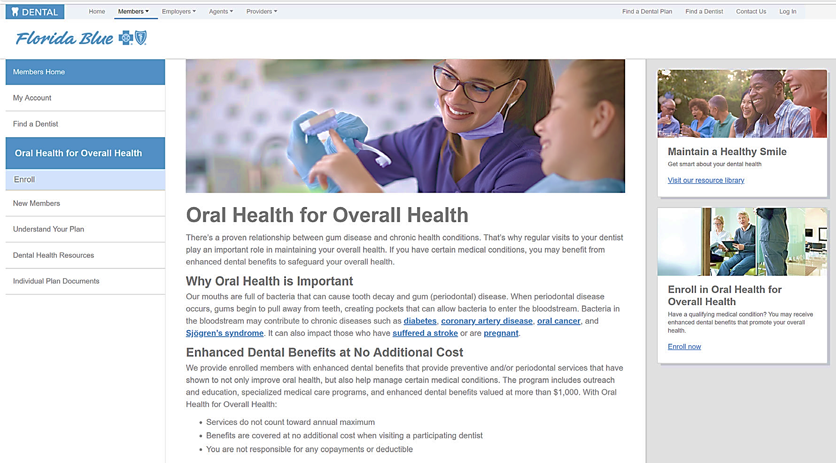
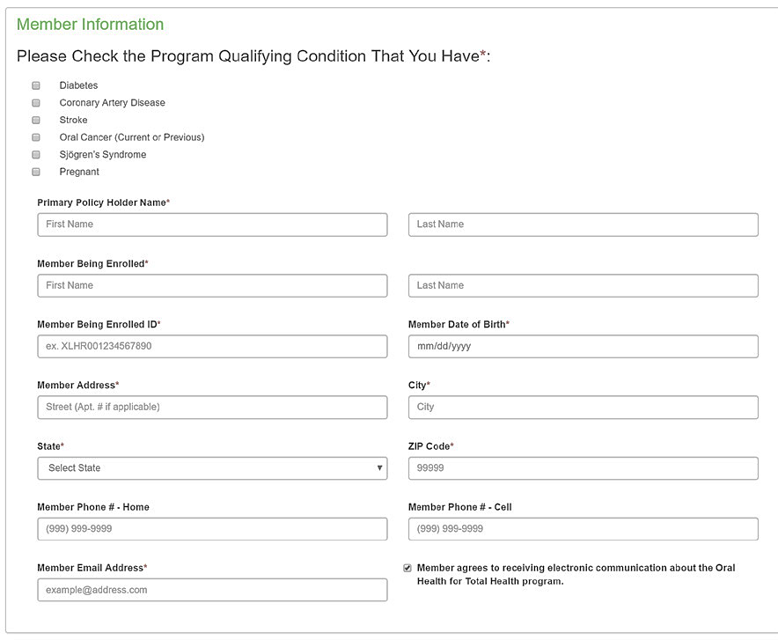
Oral Health for Overall Health℠
How to self-enroll
For those who become pregnant or only have dental coverage through Florida Blue, follow these steps to enroll.
Visit www.floridabluedental.com/members
Click “Learn More” under Oral Health for Overall Health
Click “Enroll”
Simply fill out the online enrollment form
1
2
3
4

Slide 14
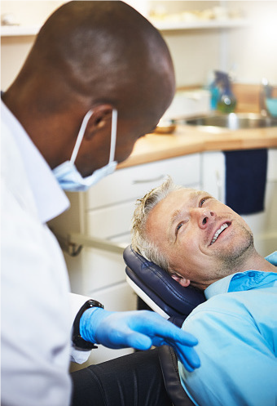
Navigating the Nationwide Dental Provider Network
Go to www.floridabluedental.com
  Click Find a Dentist, found in the navigation bar along the top of the page.
  Go to Dentist Information on the second line and choose Type of Dentist and enter the Dentist’s name.
Choose your dental insurance plan
  Choose your dental insurance plan from the drop-down menu under Insurance Plan Information (this information is available on your BlueDental ID card.) Selecting your plan ensures that your search will only list providers who are part of your plan’s network.
Choose your location
  Narrow your search by Zip Code/Distance, Address or County and click Search.
  If you’d like to narrow your search even further, click within and enter a distance. This feature will allow you to narrow your search for a dentist based on the nearest location to you.

Slide 15

Cosmetic and Orthodontic Discount Programs
Orthodontic Discount Program2
Receive a 20% discount on your total case fee when you choose an orthodontist in our Orthodontic Discount Program provider network.
Cosmetic Dental Discount Program2
Experience significant savings on cosmetic procedures
by visiting a dentist who participates in our cosmetic
dental discount network1. This discount provides a 20%
savings on the following procedures:
• Cosmetic Contouring
• Laminate Veneer (porcelain or composite)
• Whitening (in the office or at-home system)
• Implant/Abutment/Crown3
3Certain dentists have voluntarily agreed to offer a 20% discount off their usual charge for non-covered cosmetic or orthodontic services. These dentists are identified by an affiliation to either the Cosmetic Dental Discount Program or Orthodontic Discount Program. Because these dentists are neither contractually nor legally bound to offer these discounts, we recommend that you contact the provider to inquire about the continued availability of any discount prior to scheduling an appointment.
1 Networks are comprised of independent contracted dentists.
2 Certain dentists intend to offer discounted prices on certain non-covered services to our members. Because these providers are not legally required to offer
these discounts, you should contact the individual provider to inquire about the details.
20% discount does not apply if coverage for orthodontia or implants is included in your dental benefit plan.

Slide 16
New BlueDental Loyalty Program

Slide 17
Questions?

Slide 18
USAble Life
Consumer Supplemental Products

Slide 19
Supplemental Products
Product overview
Coverage is available to the applicant and their dependents
Cash benefits are paid directly to the member to use as they choose
Policy is guaranteed renewable
Rates don’t increase due to age (locked into age at effective date)
Not coordinated with health plans
Monthly, quarterly, semi-annual and annual billing options
Credit cards accepted for binder payment
Effective dates on the 1st and 15th of the month
Agents must be appointed with USAble Life to sell these products.
Accident
Accident
Critical Illness
Hospital
Two plan choices that cover select accidents in addition to accidental death or dismemberment
$10,000-$50,000 benefit options upon first diagnosis of a covered illness (i.e. cancer, heart attack, stroke)
Three plan choices that pay daily confinement amounts in addition to annual hospital admission and special ICU rates

Slide 20
Supplemental Products
Underwriting
Accident
Accident
Critical Illness
Hospital
Knock out questions determine eligibility (e.g. occupation & driver’s license)
Ineligible occupation list reduced from
24 to 14,
no sub-industries
Application is either approved or denied
Medical underwriting questions sent via web service call
Results in
<30 seconds
Applicants may be approved, denied, or approved for lower coverage
Medical underwriting questions sent via web service call
Results in
<30 seconds
Application is either approved or denied

Slide 21
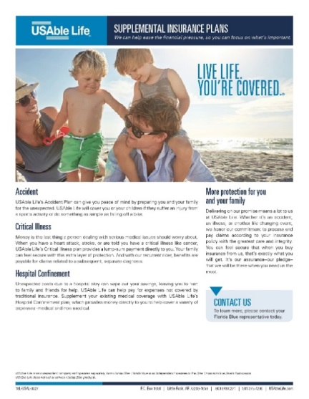
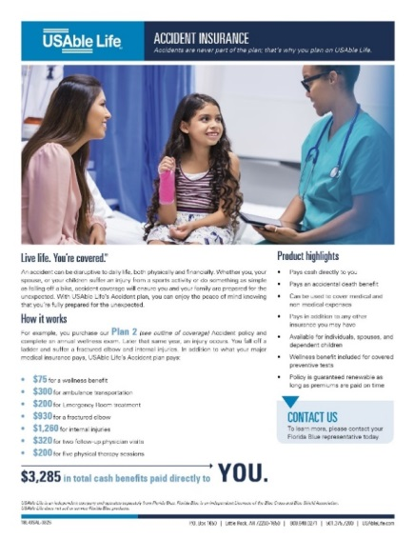
Supplemental Products
Marketing materials
Flyer
Audience: Prospects
Purpose: High-level flyer that highlights the value of each product
Outline of Coverage
Audience: Consumers
Purpose: Regulatory requirement to provide plan information during sales process

Slide 22
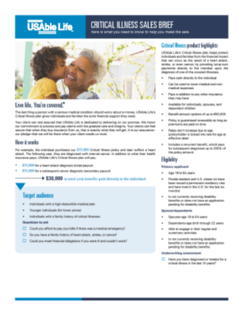
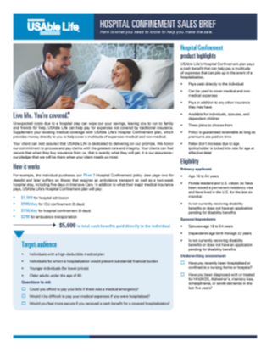

Supplemental Products
Agent collateral
Sales Briefs
Audience: Agents
Purpose: High-level product and underwriting information, intended to assist agents in selling
Field Reference Manuals
Audience: Agents
Purpose: Details to help agents with the sales and application process, as well as understand the details of the products

Slide 23
Supplemental Products
Accident – Outline of Coverage

Slide 24
Supplemental Products
Accident – Sales Brief

Slide 25
Supplemental Products
Hospital – Outline of Coverage

Slide 26
Supplemental Products
Hospital – Sales Brief

Slide 27
Supplemental Products
Critical Illness – Outline of Coverage

Slide 28
Supplemental Products
Critical Illness – Sales Brief

Slide 29
19L-USAL-0987

