Slide 1
8x8
Intro to 8x8
Using 8x8 Mobile/Desktop vs Cellphone
Recording
Sprays
Caller IDs/Lead Sources

Slide 2
8x8
What is 8x8
For the Agency
Call Transfers/Reception
Individualized Spray Group set up
Tracking numbers
Features
Call Recording
Texting (External and Internal)
For the Agent
Business Phone Number
Business phone application that you can use on a mobile phone or on your desktop
Wherever you have a headset(speaker) and microphone
Company directory
Texting
Recording
Incoming Sprays
Make sure you have 8x8 set up based on how you will use it
Mobile
Desktop
Both
ALWAYS answer or dial out using the 8x8 app NOT your cellphone carrier
Consider your desktop or mobile phone as a headset(speaker) and microphone as a conduit for the call
In order to text or record from that number

Slide 3
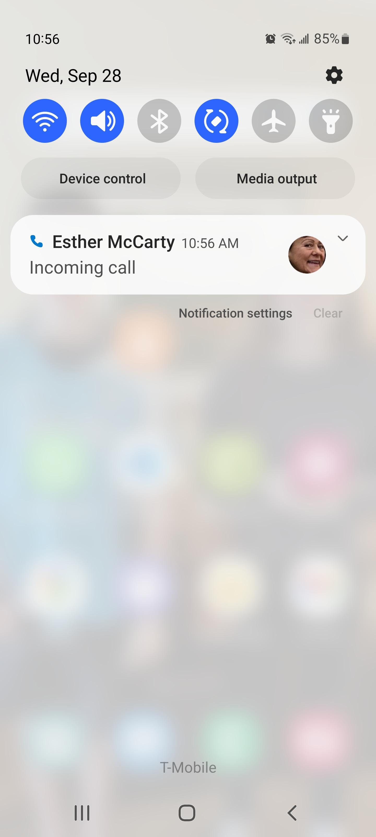
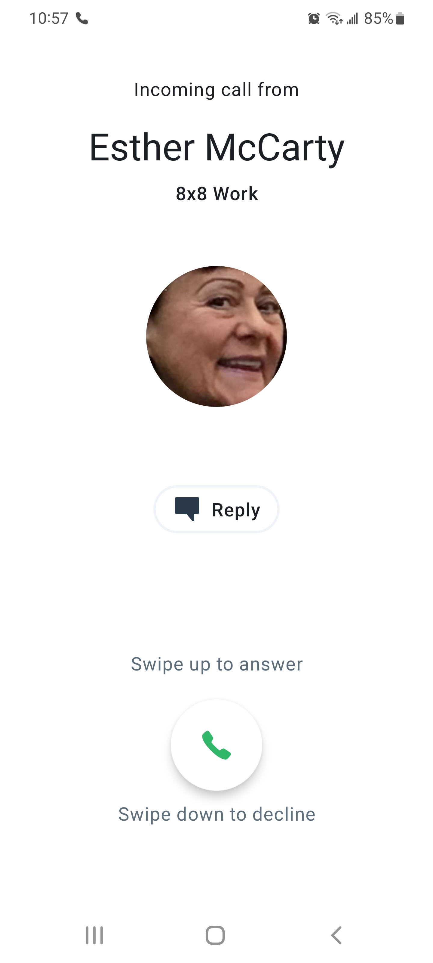
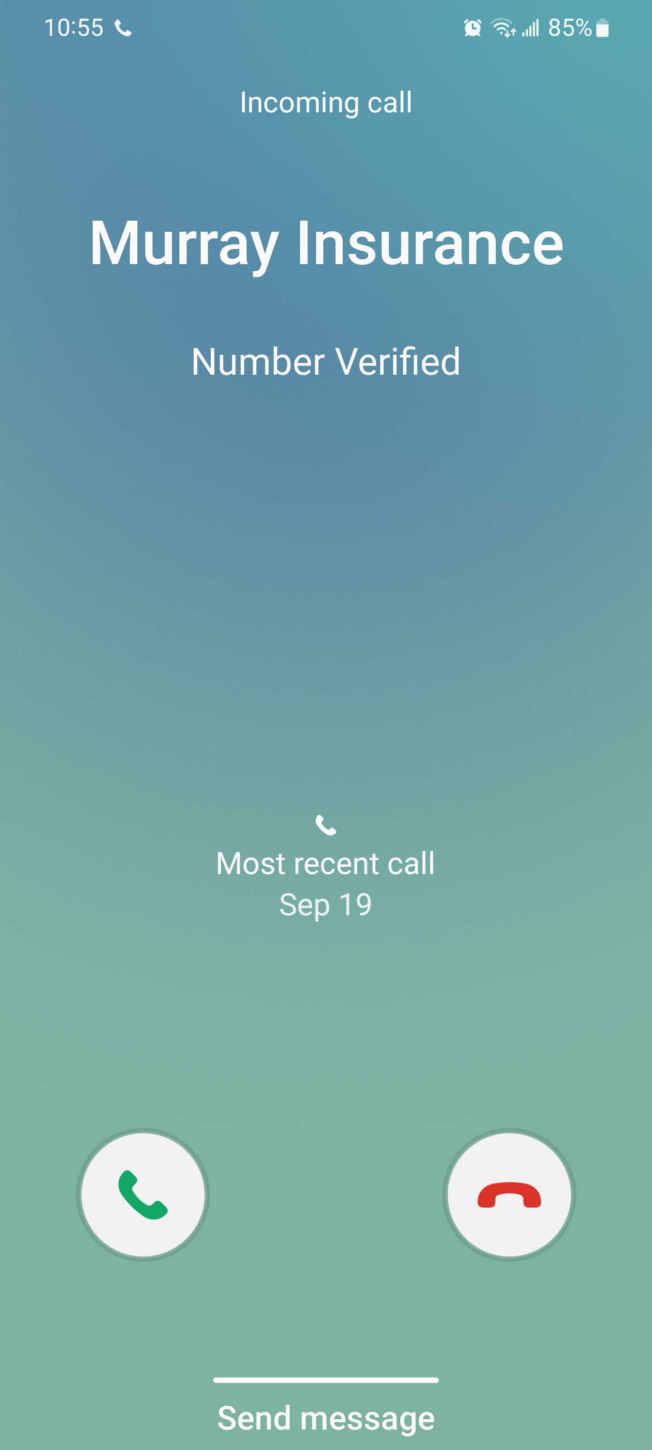
What does an incoming call look like on 8x8?
Mobile

Slide 4
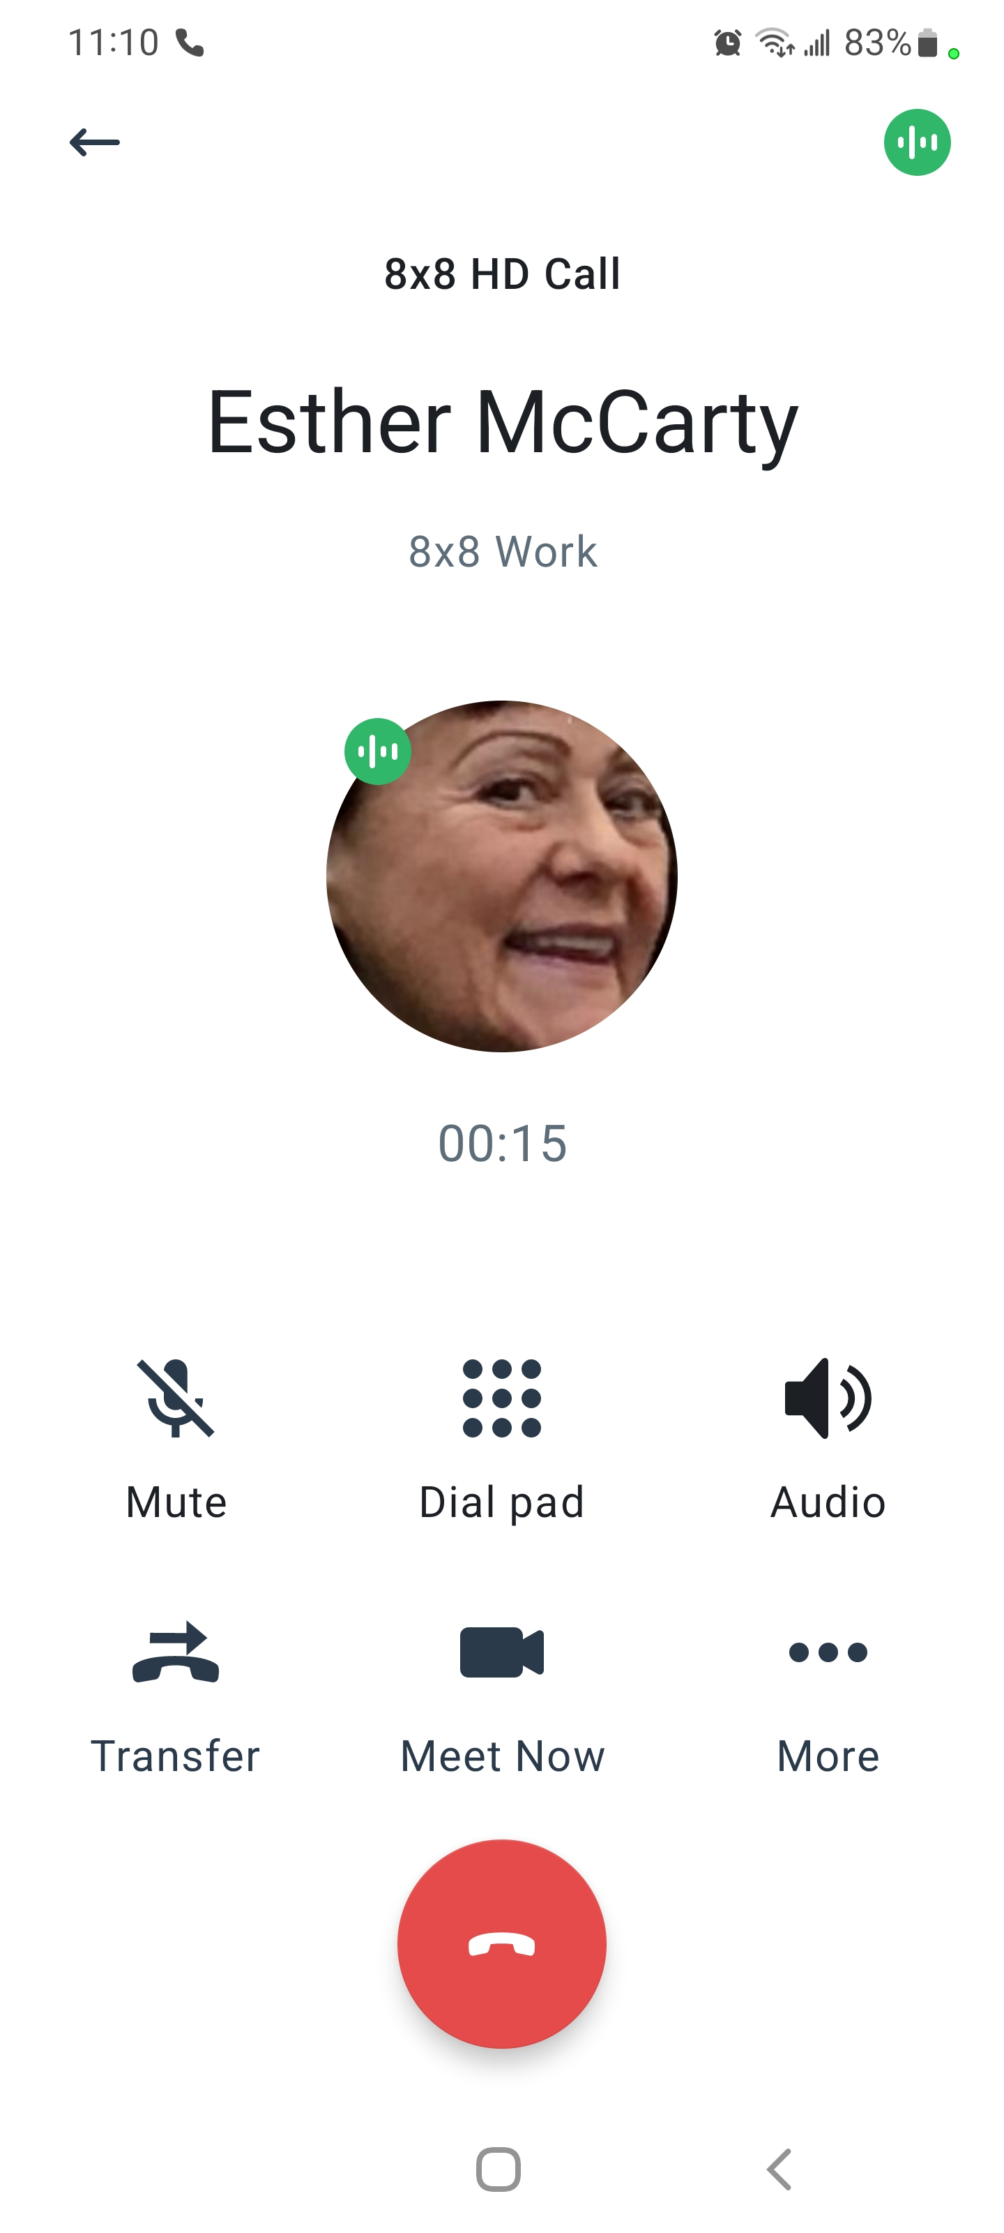
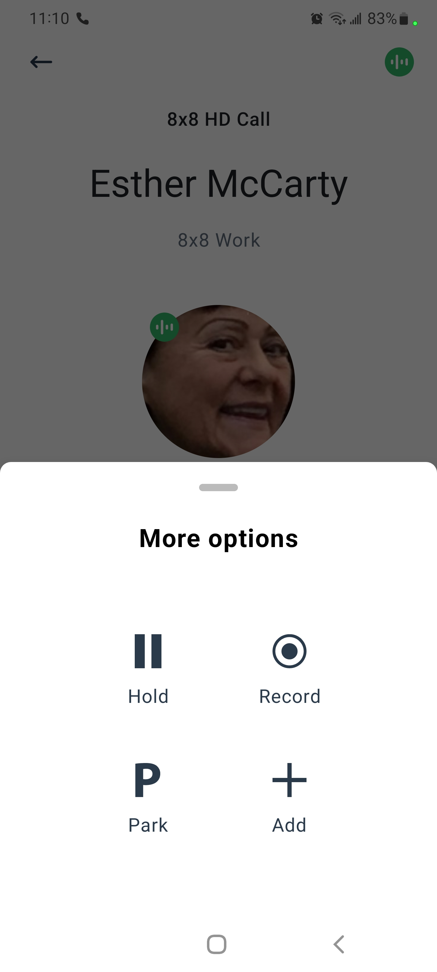
How to Record on 8x8?
Mobile Recording

Slide 5
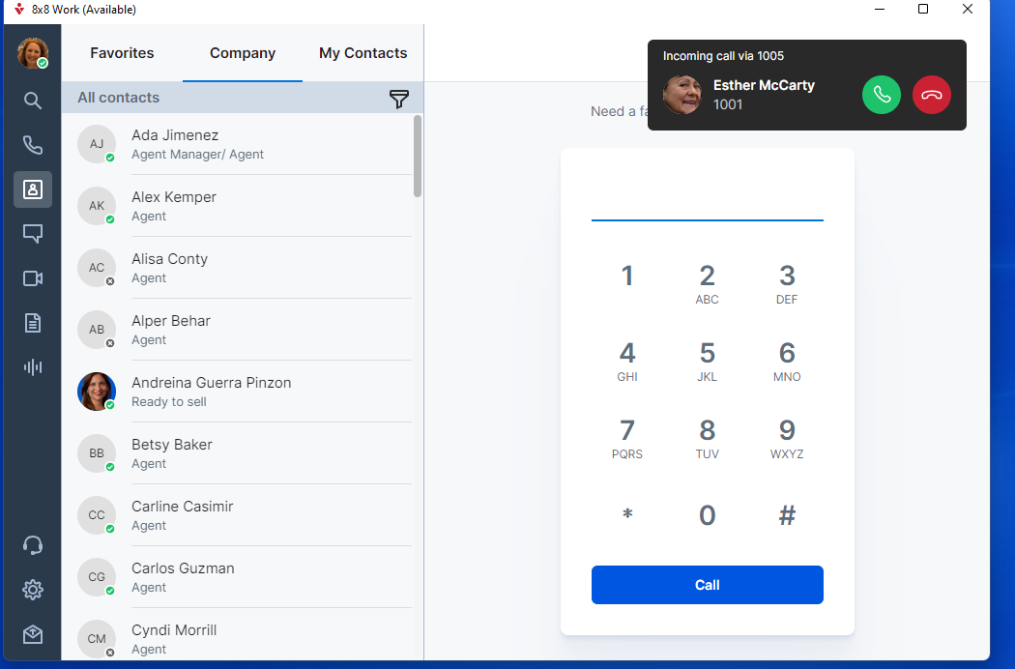
What does an incoming call look like on 8x8?
Desktop

Slide 6
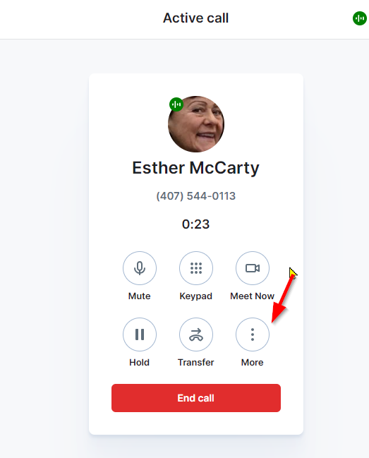
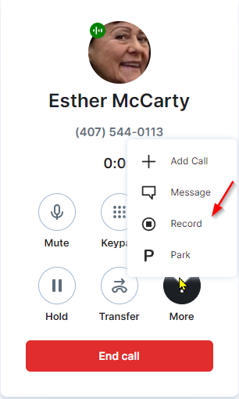
How to Record 8x8?
Desktop Recording

Slide 7
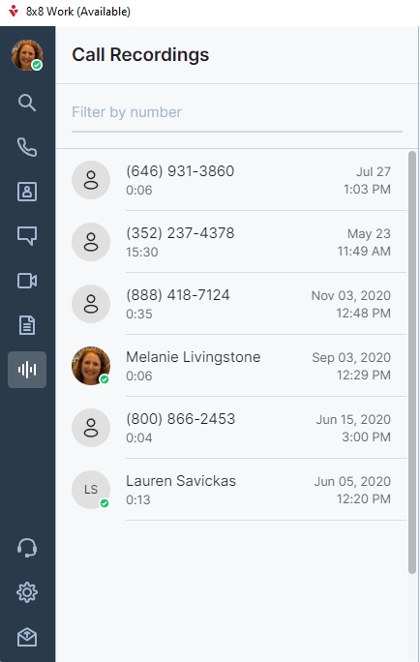
Where to find the Recording on 8x8?

Slide 8
8x8
Calls will be stored for 10 years
HIGHLY SUGGEST making a note in Agencybloc in Notes/Attachments that you spoke with this person and recorded the call.
If you have ANY concerns about a call, be sure to make a note in Agencybloc of the date and time of the call

Slide 9
8x8 – Questions??
This Meeting is being recorded and will be sent out to you as well as being stored on our Agency Resource Page under 8x8 and Medicare Tabs

