Slide 1

2020 First Look - Competitiveness
Confidential and Proprietary. Subject to CMS Approval. This communication is intended for use by agents only and is not intended for distribution to Medicare beneficiaries.

Slide 2


Summary
HMO
The data bears out that our Classic Plus/Premier HMOs are well positioned to grow
  This is a check mark for our goal during development of strengthening the existing plans and expanding into new areas with a competitive offering backed by the needed network
The Classics and FHCP still lag a bit behind
  This isn’t the best situation for areas where we only sell the Classic (Pasco, Seminole) but emphasizes the need to grow the HPNs and expand the Premier family in the coming years
  Some of them are right where we need them in the top five plans (Panhandle, Brevard) and FHCP has their local presence
  The Classic in The Villages area is better than United and we should do well against their plan
Part B Give Backs
Another check mark for our goal of offering the plans in key areas but not approach the higher end
  We sit in the lower quadrant of the amounts in each county but are not the lowest
For 2020, there are 285 PBPs returning part of the Part B premium compared to 140 last year
  However, this year the average give back is $69 vs last year just under $78
    This indicates plans are thinking the same as we did; have the plan in the portfolio but don’t lead with it
$0 LPPOs
The final check the box for our strategy of offering a competitive plan in key growth areas
  The benefit data shows these $0 plans are tightly bunched and almost indistinguishable from each other
  We are well positioned for the PPO buyer by averaging a ranking of 3.8 out of 13.4 PPO plans in the counties where we have the Value
Overall View of Plan Competitiveness in Counties having a goal of 1k or more sales
County | Lead HMO | $0 LPPO
Broward |  | --
Miami-Dade
Palm Beach | -- | --
Sumter |  | --
Volusia (FHCP) |  | N/A
Brevard (FBM) | -- | N/A
Duval
Lee | -- | --
Hillsborough |  | N/A
Orange
Pinellas | --
2

Slide 3

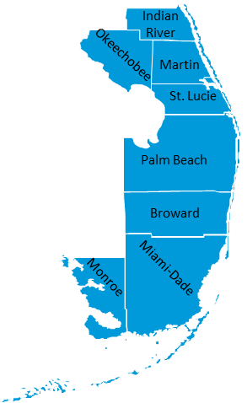

South Region

Slide 4
South Lead HMO
4

Slide 5
South Part B Give Back Amounts
5

Slide 6
South PPOs
6

Slide 7

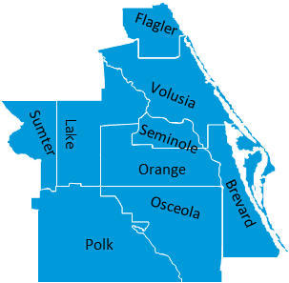
Central Region

Slide 8
Central Lead HMO
8

Slide 9
Central Part B Give Back Amounts
9

Slide 10
Central PPOs
10

Slide 11
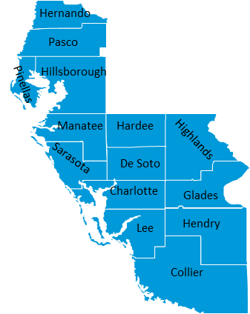
West Region

Slide 12
West Lead HMO
12

Slide 13
West Part B Give Back Amounts
13

Slide 14
West PPOs
14

Slide 15
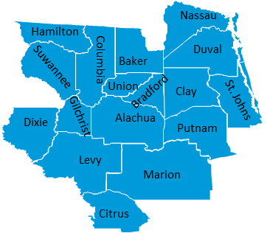
Northeast Region

Slide 16
Northeast Lead HMO
16

Slide 17
Northeast PPOs
17

Slide 18
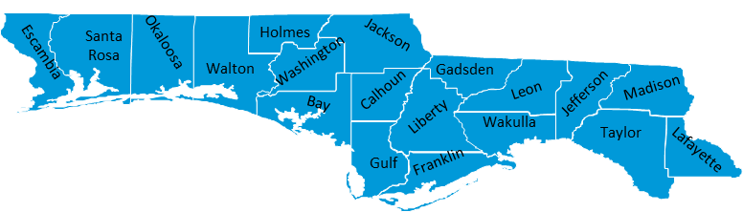
Northwest Region

Slide 19
Northwest Lead HMO
19

Slide 20
Northwest PPOs
20

